Slide 1
NON VERBAL REASONING

Slide 2
This test will test your non-verbal reasoning
as the questions appear in diagrammatic and pictorial form.
Such test are also called diagrammatic or abstract reasoning tests.
Non-verbal reasoning involves the ability to understand and analyse visual information and solve problems using visual reasoning.

Slide 3
CATEGORIES
Series
Classification
Mirror Images
Embedded Images
Figure Matrix
Paper Cutting
Grouping of Images
Shape Construction
Cubes and Dice
Analogy
Analytical Reasoning
Water Images
Pattern Completion
Paper Folding
Rule Detection
Dot Situation
Image Analysis

Slide 4
SERIES

Slide 5
1) Select a figure from amongst the Answer Figures which will continue the same series as established by the five Problem Figures.
Problem Figures: Answer Figures:
(A) (B) (C) (D) (E) (1) (2) (3) (4) (5)
1
2
3
4
5
Answer: Option C
Explanation:
In each step, element at the upper-right position gets enlarged, inverts vertically and reaches the lower-left corner; the existing element at the lower-left position, is lost and a new small element appears at the upper-right position.

Slide 6
2) Select a figure from amongst the Answer Figures which will continue
the same series as established by the five Problem Figures.
Problem Figures: Answer Figures:
(A) (B) (C) (D) (E) (1) (2) (3) (4) (5)
1
2
3
4
5
Answer: Option b
Explanation:
In each step, the elements move in the sequence.

Slide 7
3) Select a figure from amongst the Answer Figures which will continue the same series as established by the five Problem Figures.
Problem Figures: Answer Figures:
(A) (B) (C) (D) (E) (1) (2) (3) (4) (5)
1
2
3
4
5
Answer: Option a
Explanation:
Both the larger and the smaller squares move to the adjacent corner ACW in each turn. Also, the shading in the smaller square moves 1, 2, 3, 4, 5, ... steps ACW sequentially and the shading in the larger square moves 1, 2, 3, 4, 5,....

Slide 8
CLASSIFICATION

Slide 9
1) Choose the figure which is different from the rest.
(1) (2) (3) (4) (5)
1
2
3
4
5
Answer: Option a
Explanation:
The pins, equal in number to the number of sides in the main figure are attached to the midpoint of a side of the main figure in case of figures (2), (3), (4) and (5). In fig. (1), these pins are attached to a vertex of the main figure.

Slide 10
2) Choose the figure which is different from the rest.
(1) (2) (3) (4) (5)
1
2
3
4
5
Answer: Option a
Explanation:
In all other figures, the lower-right quarter portion is shaded.

Slide 11
3) Choose the figure which is different from the rest.
1
2
3
4
5
Answer: Option d
Explanation:
All other figures are divided into equal parts or even no of parts.

Slide 12
MIRROR IMAGES

Slide 13
1) Choose the alternative which is closely resembles the mirror image of the given combination.
1
2
3
4
5
Answer: Option b

Slide 14
2) Choose the alternative which is closely resembles the mirror image of the given combination.
1
2
3
4
5
Answer: Option d

Slide 15
3) Choose the alternative which is closely resembles the mirror image of the given combination.
1
2
3
4
5
Answer: Option b

Slide 16
EMBEDDED IMAGES

Slide 17
1)Find out the alternative figure which contains figure (X) as its part.
(X) (1) (2) (3) (4)
1
2
3
4
Answer: Option a

Slide 18
2) Find out the alternative figure which contains figure (X) as its part.
(X) (1) (2) (3) (4)
1
2
3
4
Answer: Option c

Slide 19
3) Find out the alternative figure which contains figure (X) as its part.
(X) (1) (2) (3) (4)
1
2
3
4
Answer: Option d

Slide 20
FIGURE MATRIX

Slide 21
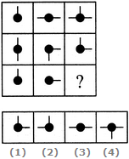
1)Select a suitable figure from the four alternatives that would complete the figure matrix
1
2
3
4
Answer: Option a

Slide 22
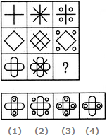
2)Select a suitable figure from the four alternatives that would complete the figure matrix
1
2
3
4
Answer: Option b

Slide 23
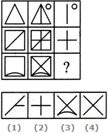
3)Select a suitable figure from the four alternatives that would complete the figure matrix
1
2
3
4
Answer: Option d

Slide 24
PAPER CUTTING

Slide 25
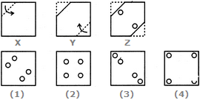
1)Choose a figure which would most closely resemble the unfolded form of Figure (Z).
1
2
3
4
Answer: Option c

Slide 26
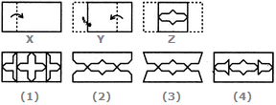
2)Choose a figure which would most closely resemble the unfolded form of Figure (Z).
1
2
3
4
Answer: Option b

Slide 27
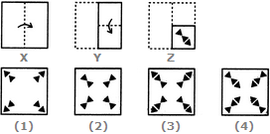
3) Choose a figure which would most closely resemble the unfolded form of Figure (Z).
1
2
3
4
Answer: Option c

Slide 28
GROUPING OF IMAGES

Slide 29
1)Group the given figures into three classes using each figure only once.
a) 1,4 ; 2,3 ; 5,6
b) 1,5 ; 2,6 ; 4,3
c) 1,6 ; 2,3 ; 4,5
d)1,2 ; 3,6 ; 4,5
Answer: Option a

Slide 30
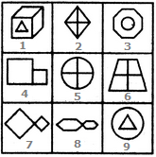
2)Group the given figures into three classes using each figure only once.
a)1,3,9 ; 2,7,8 ; 4,5,6
b)1,3,9 ; 2,5,6 ; 4,7,8
c)1,2,4 ; 3,5,7 ; 6,8,9
d)1,3,6 ; 2,4,8 ; 5,7,9
Answer: Option a
Explanation:
1, 3, 9 have one element placed inside a different element.
2, 5, 6 contain two mutually perpendicular lines dividing the figure into four parts.
4, 7, 8 have two similar elements (unequal in size) attached to each other.

Slide 31
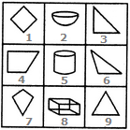
3)Group the given figures into three classes using each figure only once.
a)1,4,7 ; 2,5,8 ; 3,6,9
b)1,4,7 ; 2,5,9 ; 3,6,7
c)1,3,4 ; 2,5,8 ; 6,7,9
d)1,2,3 ; 4,5,6 ; 7,8,9
Answer: Option a
Explanation:
1, 4, 7 are all (two-dimensional) quadrilaterals.
2, 5, 8 are all three-dimensional figures.
3, 6, 9 are all (two-dimensional) triangles.

Slide 32
SHAPE CONSTRUCTION

Slide 33
1)Select the alternative which represents three out of the five alternative figures which when fitted into each other would form a complete square.
145
245
123
234
Answer: Option b
Explanation:

Slide 34
2)Select the alternative which represents three out of the five alternative figures which when fitted into each other would form a complete square.
134
345
234
135
Answer: Option c
Explanation:

Slide 35
3)Select the alternative which represents three out of the five alternative figures which when fitted into each other would form a complete square.
123
234
345
245
Answer: Option c
Explanation:

Slide 36
CUBES AND DICE

Slide 37
1) Choose the box that is similar to the box formed from the given sheet of paper (X).
1 and 2
2 and 4
2 and 3
1 and 4
Answer: Option c
Explanation:
The fig. (X) is similar to the Form VI. . However, the cube in fig. (1) has two such faces and fig. (4) has a face which is completely shaded. So, these two cubes cannot be formed. Hence, only the cubes in figures (2) and (3) can be formed.

Slide 38
2)How many dots lie opposite to the face having three dots, when the given figure is folded to form a cube?
Answer: Option d
Explanation:
The given figure is similar to Form V. Therefore, when this figure is folded to form a cube then the face bearing six dots will lie opposite the face bearing three dots.
2
4
5
6

Slide 39
3) Choose the box that is similar to the box formed from the given sheet of paper (X).
1 and 2 only
2 , 3 and 4 only
3 only
3 and 4 only
Answer: Option d
Explanation:
The fig. (X) is similar to the Form V. So, when the sheet in fig. (X) is folded to form a cube, then the face bearing a square lies opposite to the face bearing a circle. Therefore, the cubes shown in figures (1) and (2) which have the faces bearing the square and the circle adjacent to each other, cannot be formed. Hence, only the cubes in figures (3) and (4) can be formed.

Slide 40
ANALOGY

Slide 41
1)Select a suitable figure from the Answer Figures that would replace the question mark (?).
Problem Figures: Answer Figures:
(A) (B) (C) (D) (1) (2) (3) (4) (5)
1
2
3
4
5
Answer: Option C
Explanation:
The half-shaded leaf rotates 135ºACW and the unshaded leaf rotates 135ºCW.

Slide 42
2)Select a suitable figure from the Answer Figures that would replace the question mark (?).
Problem Figures: Answer Figures:
(A) (B) (C) (D) (1) (2) (3) (4) (5)
1
2
3
4
5
Answer: Option B
Explanation:
Each one of the upper elements is replaced by an element similar to the lower element(s) and each one of the lower elements is replaced by an element similar to the upper element(s).

Slide 43
3)Select a suitable figure from the Answer Figures that would replace the question mark (?).
Problem Figures: Answer Figures:
(A) (B) (C) (D) (1) (2) (3) (4) (5)
1
2
3
4
5
Answer: Option C
Explanation:
Except for the dots, the remaining part of the figure rotates through 180º and shifts to the opposite side of the square boundary.

Slide 44
ANALYTICAL REASONING

Slide 45
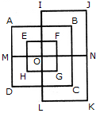
1)Find the minimum number of straight lines required to make the given figure
Answer: Option A
Explanation:
The figure may be labelled as shown.
The horizontal lines are IJ, AB, EF, MN, HG, DC and LK i.e. 7 in number.
The vertical lines are AD, EH, IL, FG, BC and JK i.e. 6 in number.
Thus, there are
7 + 6 = 13 straight lines in the
13
15
17
19

Slide 46
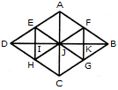
2)Find the number of triangles in the given figure.
16
22
28
32
Answer: Option C
Explanation:
The figure may be labelled as shown.

Slide 47
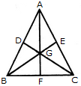
.
3)Find the number of triangles in the given figure.
16
13
9
7
Answer: Option A
Explanation:
The figure may be labelled as shown.

Slide 48
WATER IMAGES

Slide 49
1)Choose the alternative which is closely resembles the water-image of the given combination.
1
2
3
4
Answer: Option B

Slide 50
2)Choose the alternative which is closely resembles the water-image of the given combination.
1
2
3
4
Answer: Option D

Slide 51
3)Choose the alternative which is closely resembles the water-image of the given combination.
1
2
3
4
Answer: Option D

Slide 52
PATTERN COMPLETION

Slide 53
1)Identify the figure that completes the pattern.
(X) (1) (2) (3) (4)
1
2
3
4
Answer: Option D
Explanation:

Slide 54
2)Identify the figure that completes the pattern.
(X) (1) (2) (3) (4)
1
2
3
4
5
Answer: Option B
Explanation:

Slide 55
3)Identify the figure that completes the pattern.
1
2
3
4
Answer: Option D
Explanation:

Slide 56
PAPER FOLDING

Slide 57
1)Find out from amongst the four alternatives as to how the pattern would appear when the transparent sheet is folded at the dotted line.
(X) (1) (2) (3) (4)
1
2
3
4
Answer: Option D

Slide 58
2)Find out from amongst the four alternatives as to how the pattern would appear when the transparent sheet is folded at the dotted line.
(X) (1) (2) (3) (4)
1
2
3
4
Answer: Option D

Slide 59
3)Find out from amongst the four alternatives as to how the pattern would appear when the transparent sheet is folded at the dotted line.
(X) (1) (2) (3) (4)
1
2
3
4
Answer: Option B

Slide 60
RULE DETECTION

Slide 61
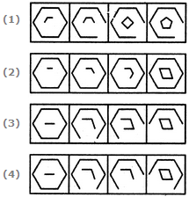
1)Choose the set of figures which follows the given rule.
Rule: Closed figures losing their sides and open figures gaining their sides
1
2
3
4
Answer: Option C

Slide 62
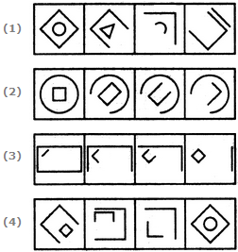
2)Choose the set of figures which follows the given rule.
Rule: Closed figures gradually become open and open figures gradually become closed.
1
2
3
4
Answer: Option C

Slide 63
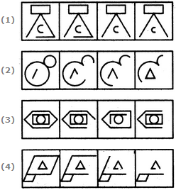
3)Choose the set of figures which follows the given rule.
Rule: Closed figures become more and more open and open figures become more and more closed.
1
2
3
4
Answer: Option B

Slide 64
DOT SITUATION

Slide 65
1)Select the figure which satisfies the same conditions of placement of the dots as in Figure-X.
1
2
3
4
Answer: Option D

Slide 66
2)Select the figure which satisfies the same conditions of placement of the dots as in Figure-X.
1
2
3
4
Answer: Option B

Slide 67
3)Select the figure which satisfies the same conditions of placement of the dots as in Figure-X.
1
2
3
4
Answer: Option D

Slide 68
IMAGE ANALYSIS

Slide 69
1)Find out which of the figures (1), (2), (3) and (4) can be formed from the pieces given in figure (X).
1
2
3
4
Answer: Option C

Slide 70
2)Find out which of the figures (1), (2), (3) and (4) can be formed from the pieces given in figure (X).
1
2
3
4
Answer: Option C

Slide 71
3)Find out which of the figures (1), (2), (3) and (4) can be formed from the pieces given in figure (X).
1
2
3
4
Answer: Option A

