Slide 1
Number System,
Number system is a way to represent numbers or quantities and symbols. We are using the base-10 number system, which is also called decimal.
Decimal is a base or radix 10 number system. This means that the symbols or numerals to represent any quantity. These symbols are called digits. The ten symbols are
1, 2, 3, 4, 5, 6, 7, 8, 9, 0.
base-2 (binary), use of 0, 1
base-8 (octal), use of 0, 1, 2, 3, 4, 5, 6, 7
and base-16 (hexadecimal).0, 1, 2, 3, 4, 5, 6, 7, 8, 9, A, B, C,D, E, F

Slide 2
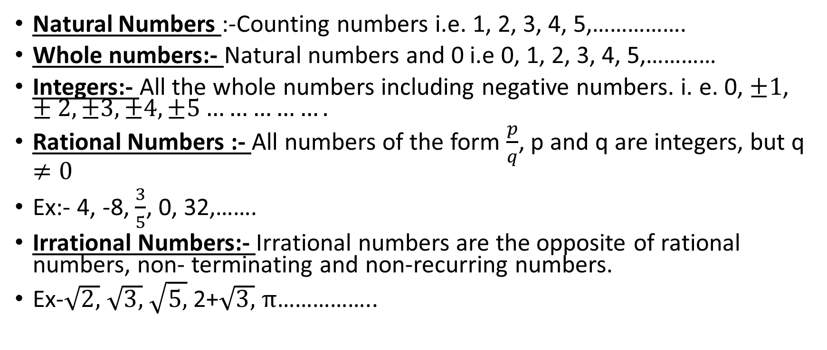
Type of Numbers.
Natural Numbers :-Counting numbers i.e. 1, 2, 3, 4, 5,…………….
Whole numbers:- Natural numbers and 0 i.e 0, 1, 2, 3, 4, 5,…………
Integers:- All the whole numbers including negative numbers. i. e. 0, $±1$, $±2, ±3, ±4,±5…………….$
Rational Numbers :- All numbers of the form $\frac{p}{q}$, p and q are integers, but q $≠0$
Ex:- 4, -8, $\frac{3}{5}$, 0, 32,…….
Irrational Numbers:- Irrational numbers are the opposite of rational numbers, non- terminating and non-recurring numbers.
Ex-$\sqrt{2, }$ $\sqrt{3, }$ $\sqrt{5, }$ 2+$\sqrt{3, }$ $π$……………..

Slide 3
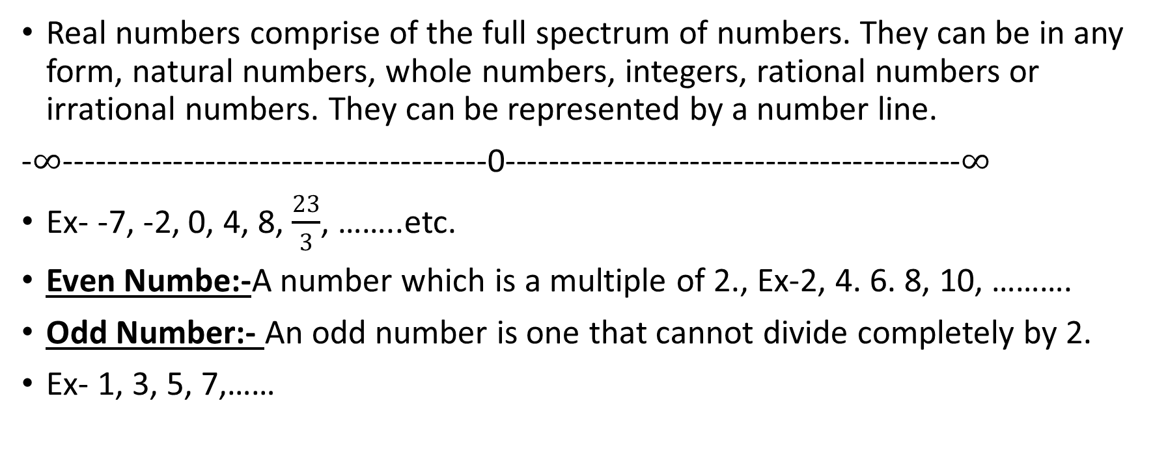
Real Numbers
Real numbers comprise of the full spectrum of numbers. They can be in any form, natural numbers, whole numbers, integers, rational numbers or irrational numbers. They can be represented by a number line.
-$∞$---------------------------------------0------------------------------------------$∞$
Ex- -7, -2, 0, 4, 8, $\frac{23}{3}$, ……..etc.
Even Numbe:-A number which is a multiple of 2., Ex-2, 4. 6. 8, 10, ……….
Odd Number:- An odd number is one that cannot divide completely by 2.
Ex- 1, 3, 5, 7,……

Slide 4
Prime Number
A prime number is a number, which can be divided by 1 and itself. 2 is the only even number which is prime number.
Example of prime numbers- 2, 3, 5, 7, 11, 13, 17,……..
Composite Number:- A composite number is a number which can be divided by number of factors other than 1 and itself.
Ex- 4, 6, 8, 9, 10, 14,………..
Co-Primes or relatively prime:- A pair of numbers not having any common factors other than 1 or -1. Or we can say the greatest common factor is 1 or -1.
Ex-15 and 28 are co-prime, because the factor of 15 are 1,3,5,15 and the factor of 28 is 1, 2, 4,7, 14, 28. They have no common factors except 1.

Slide 5
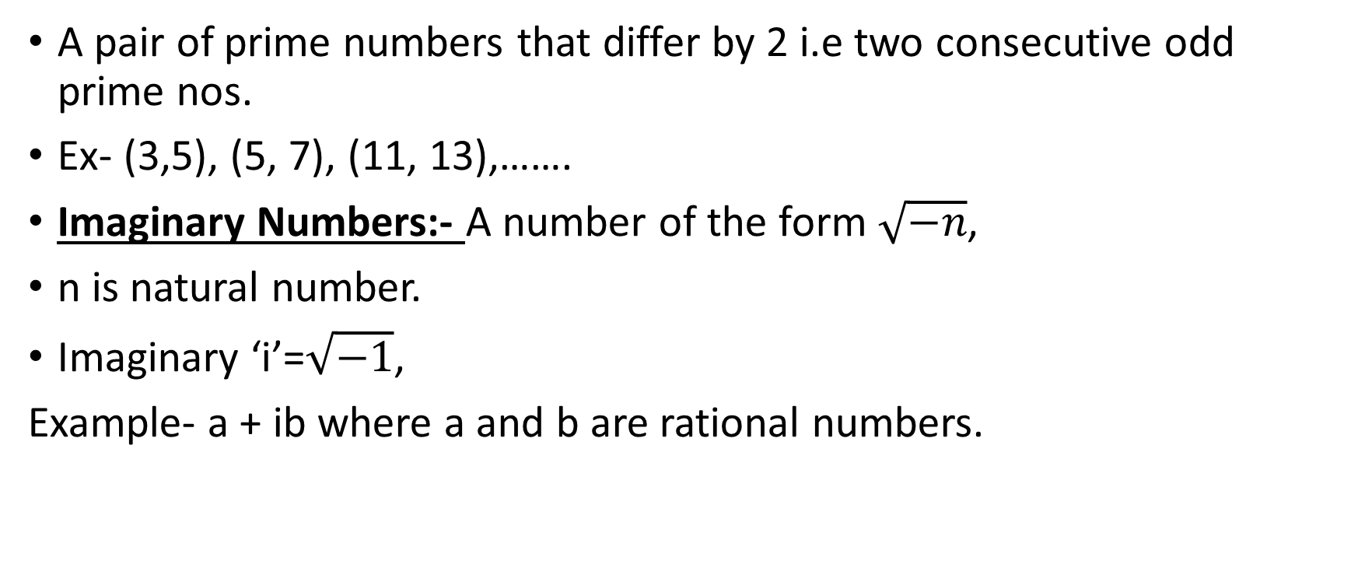
Twin prime
A pair of prime numbers that differ by 2 i.e two consecutive odd prime nos.
Ex- (3,5), (5, 7), (11, 13),…….
Imaginary Numbers:- A number of the form $\sqrt{−n}$,
n is natural number.
Imaginary ‘i’=$\sqrt{−1}$,
Example- a + ib where a and b are rational numbers.

Slide 6
Thank you

