Slide 1
INEQUALITY
An inequality says that two values are not equal.
a ≠ b says that a is not equal to b
There are other special symbols that show in what way things are not equal.
a < b says that a is less than b
a > b says that a is greater than b
(those two are known as strict inequality)

Slide 2
INEQUALITY
a ≤ b means that a is less than or equal to b
a ≥ b means that a is greater than or equal to b.
An inequality is like an equation that uses symbols for "less than"(<) and "greater than"(>) where an equation uses a symbol for "is equal to" (=).
So where the equation:
x = y + 5 says that “x is equal to y plus 5",
x < y + 5 says that “x is less than y plus 5", and
x > y + 5 says that “x is greater than y plus 5".

Slide 3
INEQUALITY
Problem :
1. Substitute the ? in the following expression for the correct inequality symbol:
4 ? 5 Ans - <
2. Substitute the ? in the following expression for the correct inequality symbol:
99999909 ? 99999099 Ans- >

Slide 4
INEQUQLITIES
Symbol Words Example
> greater than x + 9 >2
< smaller than 5x + 4 < 3
≥ Greater than equal to 5 ≥ x – 7
≤ Less than equal to 3x -7≤34

Slide 5
INEQUALITIES
Many simple inequalities can be solved by adding, subtracting, multiplying or dividing both sides.
But these things will change direction of the inequality.
Multiplying or dividing both sides by a negative number.
Swapping left and right hand side.

Slide 6
INEQUALITIES
Example: x + 62 > 126
Ans:- Subtract 62 in left hand side and right hand side
Hence x + 62 – 62 > 126 – 62 => X > 64 (solved)
Adding (or subtracting) a number in both sides and Multiplying
(or dividing) both sides by a positive number
Example: 13x < 7+32
=> 13x < 39 (Adding in right)
=> x < 3(Dividing 13 in both sides)

Slide 7
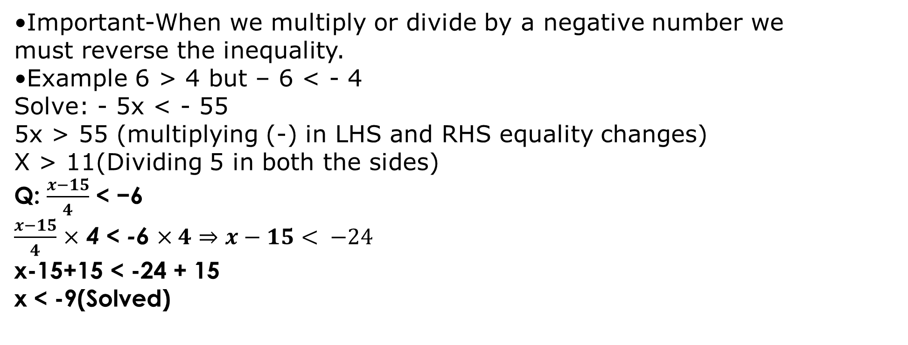
INEQUALITIES
Important-When we multiply or divide by a negative number we must reverse the inequality.
Example 6 > 4 but – 6 < - 4
Solve: - 5x < - 55
5x > 55 (multiplying (-) in LHS and RHS equality changes)
X > 11(Dividing 5 in both the sides)
Q: $\frac{x−15}{4}$ < −6
$\frac{x−15}{4}$ $×$ 4 < -6 $×4⇒x−15< −24$
x-15+15 < -24 + 15
x < -9(Solved)

