Slide 1
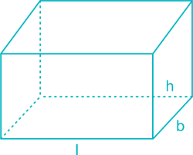
Geometry 3D
CUBOID(Rectangular Parallelepiped)
A solid bounded by 6 rectangular plane regions.
Let l = length, b = breadth and h = height
Total lateral surface area of cuboid = 2 (bh + lh) =2h(b+l)
Total surface area of cuboid = 2 (lb + bh + lh)
Length of diagonal of cuboid= $\sqrt{\text{(}\text{l}\text{2}\text{+}\text{b}\text{2}\text{+}\text{h}\text{2}\text{)}}$
Volume of cuboid = l × b × h
Q1) if we have a cuboid whose length, breadth and height are 15 cm,10 cm and 20 cm respectively, then its total surface area and volume would be
2[(15 × 10) + (10 × 20) + (20 × 15)] cm2
= 2(150 + 200 + 300) 2c$c\text{m}\text{2}$
= 2 × 650 2c$c\text{m}\text{2}$
= 1300 c$\text{m}\text{2}$
VOLUME:L×B×H = 15×10×20 = 3000 c$\text{m}\text{3}$

Slide 2
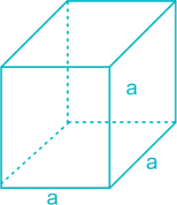
CUBE
A cuboid whose length, breadth and height are all equal is called a cube.
It has 6 faces which are squares.
Let ‘a’ be the edge of cube.
The lateral surface area of a cube = 4a²
Total surface area of cube = 6a²
Volume of a cube = a³
Length of Leading Diagonal of Cube = a√3

Slide 3
Example2 : Hameed has built a cubical water tank with lid for his house, with each
outer edge 1.5 m long. He gets the outer surface of the tank excluding the base,
covered with square tiles of side 25 cm. Find how much he would spend for the tiles,
if the cost of the tiles is Rs 360 per dozen.
Solution : Since Hameed is getting the five outer faces of the tank covered with tiles,
he would need to know the surface area of the tank, to decide on the number of tiles
required.
Edge of the cubical tank = 1.5 m = 150 cm (= a)
So, surface area of the tank = 5 × 150 × 150 cm²
Area of each square tile = side × side = 25 × 25 cm²
So, the number of tiles required =$\frac{\text{surface} \text{area} \text{of} \text{the} \text{tank} }{\text{area} \text{of} \text{each} \text{tile}}$ = $\frac{\text{5 }\text{×}\text{150 }\text{×}\text{150}}{\text{25 }\text{×}\text{ 25}}$= 180
Cost of 1 dozen tiles, i.e., cost of 12 tiles = Rs 360
Therefore, cost of one tile = $\frac{\text{360}}{12}$= Rs 30
So, the cost of 180 tiles = 180 × Rs 30 = Rs 5400

Slide 4
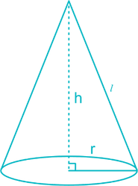
CONE
Cone is a solid generated by revolving a line segment which passes through a fixed point and which makes a constant angle with the fixed line.
The base of the cone have a plane end which is circular in shape.
Let r = radius of base, l = slant height of cone and h = height of the cone (perpendicular to base)
Slant height of a cone = l =$\sqrt{\text{(}\text{h}\text{2}\text{+}\text{r}\text{2}\text{ )}}$
Curved surface area of a cone = C = π × r × l
Total surface area of a cone = π$\text{r}\text{2}$ + π r l =π r (r + l) = π r (l + r)
Volume of right circular cone =$\frac{1}{3}$ πr²h

Slide 5
Q.3) Diameter of the base of a cone is 10.5 cm and its slant height is 10 cm. find
its curved surface area.
Sol. Here, diameter = 10.5cm hence radius = 5.25 and l =10cm
Curved surface area of the cone = π r l
= $\frac{22}{7}$ × 5.25 × 10
= 165 cm²
Q.4) Find the total surface area of a cone, if its slant height is 21 m and
diameter of its base is 24 m.
Sol. Here, l = 21 m, r = 12m
Total surface area of the cone = πr(l + r)
= $\frac{22}{7}$ × 12 (21 + 12) m² =1244.57 m².

Slide 6
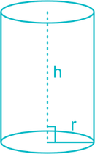
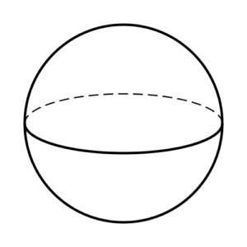
Cylinder
A solid generated by revolution of a rectangle about one of it’s sides is called cylinder.
Let r = radius of base and h = height of cylinder
Curved surface area of a cylinder = 2πrh
Total surface area of a cylinder = 2πr² + 2πrh = 2πr(r + h)
Volume of a cylinder = πr²h
SPHERE
The set of all points in space which are equidistant from a
fixed point is called a sphere.
Fixed point is called the centre of the sphere and the constant distance is called it’s radius.
If r = radius of sphere, d = diameter of sphere
Surface area of a sphere = 4πr² = πd²
Volume of a sphere = ($\frac{4}{3}$) πr³ = ($\frac{1}{6}$)πd³

Slide 7
Q.5. The curved surface area of a right circular cylinder of height 14 cm is 88 cm². Find the diameter of the base of the cylinder.
Sol. Here, h = 14 cm, curved, surface area = 88 cm², r = ?
Curved surface area of the cylinder = 2πrh
⇒ 88 = 2 × $\frac{22}{7}$ × r × 14
⇒ 88 = 44 × r× 2
⇒ r = $\frac{88}{44\text{× 2 }}$
=1cm
Therefore the diametre is = 2r =2cm
Q.6. It is required to make a closed cylindrical tank of height 1m and base diameter 140 cm from a metal sheet. How many square metres of the sheet are required for the same?.
Sol. Here, h = 1 m, d = 140cm , r=0.7m
Total surface area of the cylinder = 2πr (h + r)
= 2 ×$\frac{22}{7}$ × 0.7 (1 + 0.7) m²
= 44 × 0.1 × 1.7 m² = 7.48 m²
Hence, 7.48 m² of sheet is required (Ans.)

Slide 8
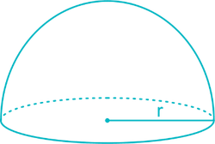
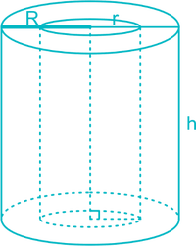
Hemisphere
A plane through the centre of a sphere divides the sphere into two equal parts,
each of which is called a hemi-sphere.
Let r = radius of sphere
Volume of a hemisphere =($\frac{2}{3}$)πr³
Curved surface area of a hemisphere = 2πr²
Total surface area of a hemisphere = 2πr² + πr² = 3πr²
Hollow Cylinder
A solid bounded by 2 co axial cylinder of the same height and different
Radii is called a hollow cylinder.
Cylinder of same height and orientation out of a bigger cylinder.
Volume of hollow cylinder = πh(R²– r²)
(Where, R = radius of cylinder, r = radius of cavity, and
h = height of cylinder)

Slide 9
Q.7. A hemispherical bowl made of brass has inner diameter 10.5 cm. Find the cost of tin-plating it on the inside at the rate of Rs 16 per 100 cm².
Sol. Here d= 10.5cm then r = 5.25 cm ,
Rate of tin plating= Rs $\frac{16}{100}$cm²
Inner surface area of the bowl = 2πr²
= 2 ×$\frac{22}{7}$ × (5.25)2 cm²
= 44 × 0.75 × 5.25 cm2 = 173.25 cm²
Cost of tin plating 100 cm² = Rs 16
Cost of tin plating 173.25 cm² = Rs$\frac{16}{100}$ × 173.25 = Rs 27.72 Ans.

Slide 10
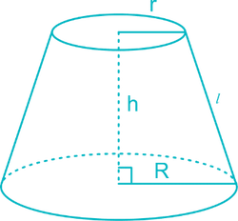
FRUSTUM OF A RIGHT CIRCULAR CONE
Frustum is created when a plane cuts a cone parallel to its base. In the following formulae, R = radius of the base of the frustum, r = radius of the top of the frustum, h = height of the frustum, l = slant height of the frustum If a cone is cut by a plane parallel to the base of the cone, the lower part is called the frustum of the cone.
Slant height of the frustum =l=$\sqrt{\text{(}\text{h}\text{2}\text{+(}\text{R}\text{−}\text{r}\text{)2}}$)
Curved surface area of frustum = π(R + r)l
Total surface area of frustum = π(R + r)l + π(R² + r²)
Volume of the frustum=($\frac{1}{3}$)πh(R²+r²+Rr)

Slide 11
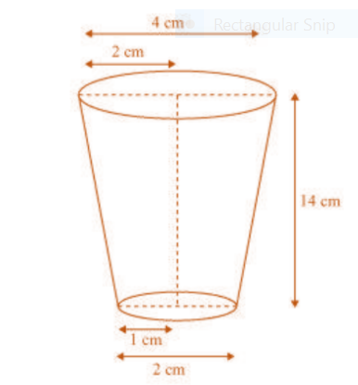
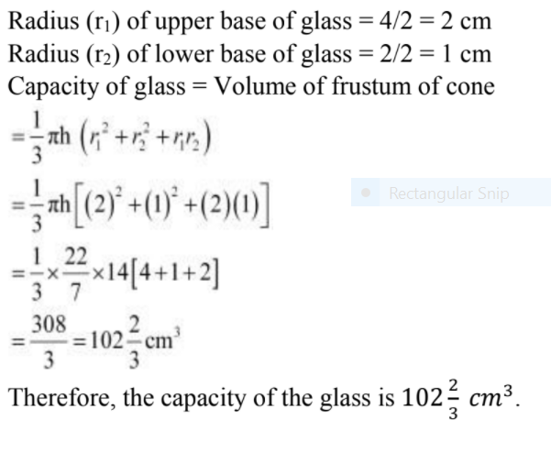

Slide 12
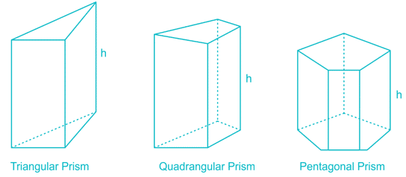
PRISM
Prism consists of two polygonal bases which are parallel to each other.
These bases are joined by lateral faces, which are perpendicular to the polygonal bases.
The number of lateral faces is equal to the number of sides in the polygonal base. Thus, the base of a prism could be of various shapes, namely, triangular, quadrangular, pentagonal etc.
Volume of prism = Base area × height
Lateral surface area of prism = perimeter of base × height
Total surface area of prism = Lateral surface area + (2 × base area)

Slide 13
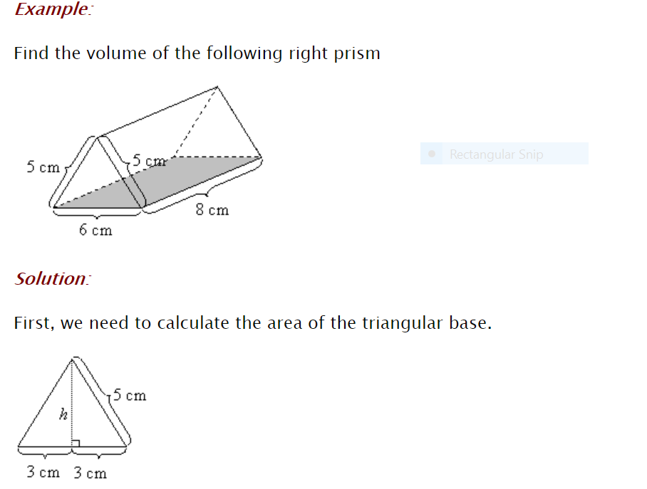

Slide 14
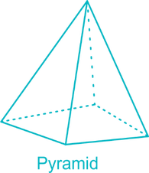
Pyramid
Pyramid consists of a polygonal base and triangles at its sides. These triangles are called faces.
The base could be of any shape, whereas the faces are generally isosceles triangles.
All these triangular faces meet in a single point called the apex.
Total surface area of pyramid = base area + (number of sides × ½ × slant height × base length)
Volume of pyramid = (1/3) × base area × height

