Slide 1
Learn and Excel Pvt Ltd
Mathematics

Slide 2
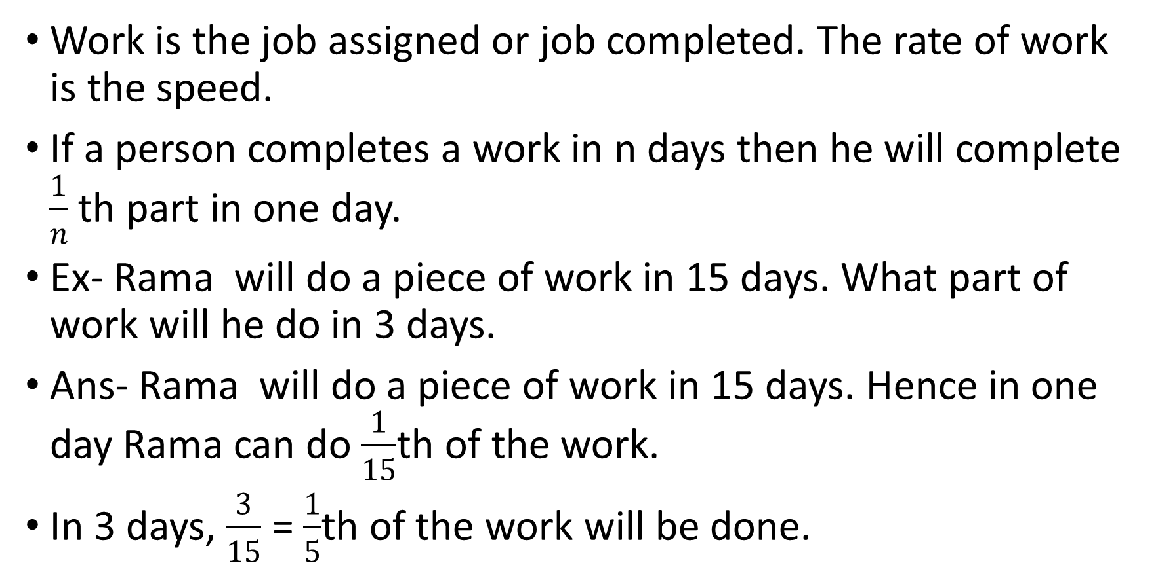
Time and work,
Work is the job assigned or job completed. The rate of work is the speed.
If a person completes a work in n days then he will complete $\frac{1}{n}$ th part in one day.
Ex- Rama will do a piece of work in 15 days. What part of work will he do in 3 days.
Ans- Rama will do a piece of work in 15 days. Hence in one day Rama can do $\frac{1}{15}$th of the work.
In 3 days, $\frac{3}{15}$ = $\frac{1}{5}$th of the work will be done.

Slide 3
Example of Time and work
If A and B can do a piece of work in x and y days respectively, while working alone, they will together take $\frac{xy}{x+y}$ days to complete the work.
If A, B and C can do a piece of work in x, y and z days respectively, while working alone, they will together take $\frac{xyz}{x+y+z}$ days to complete the work.
If A can finish a job in x days and B in y days and A, B and C together in s days then,
C can finish the work alone in = $\frac{sxy}{xy−sz−sx}$
B + C can finish in $\frac{xs}{x−s}$, A + C can finish in $\frac{sy}{y−s}$ days

