Slide 1
Sequences of Real Numbers
An Introduction

Slide 2
What is a sequence?
Informally
A sequence is an infinite list.
In this class we will consider only sequences of real numbers, but we could think about sequences of sets, or points in the plane, or any other sorts of objects.

Slide 3
What about sequences?
The entries in the list don’t have to be different.
The entries in the list don’t have to follow any particular pattern.

Slide 4
What about sequences?
The entries in the list don’t have to be different.
The entries in the list don’t have to follow any particular pattern.
Though, in practice, we are often interested in sequences that do have some sort of pattern or regularity!

Slide 5
What is a sequence of real numbers?
More formally. . .
A sequence of real numbers is a function in which the inputs are positive integers and the outputs are real numbers.
Or Perhaps it’s easier to think of it this way…

Slide 6
What is a sequence of real numbers?
More formally. . .
A sequence of real numbers is a function in which the inputs are positive integers and the outputs are real numbers.
The input gives the position in the sequence, and the output gives its value.

Slide 7
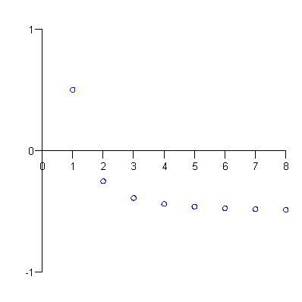
Graphing Sequences
Since sequences of real numbers are functions from the positive integers to the real numbers, we can plot them, just as we plot other functions. . .
There’s a “y” value for every positive integer.

Slide 8
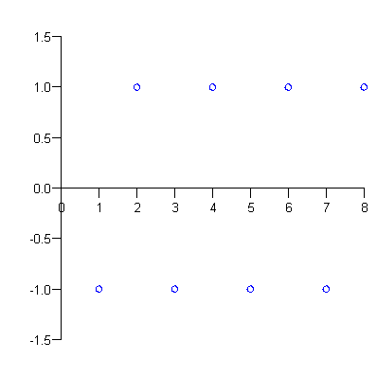
Graphing Sequences
Since sequences of real numbers are functions from the positive integers to the real numbers, we can plot them, just as we plot other functions. . .
There’s a “y” value for every positive integer.

Slide 9
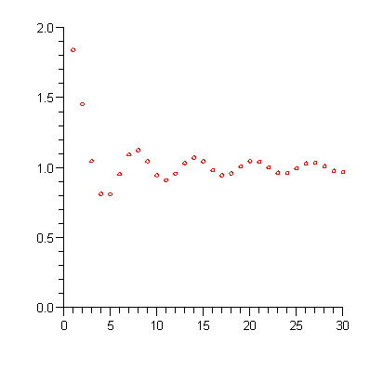
Graphing Sequences
Since sequences of real numbers are functions from the positive integers to the real numbers, we can plot them, just as we plot other functions. . .
There’s a “y” value for every positive integer.

Slide 10
Terminology and notation
We write a “general” sequence as
Individual entries in the list are called the terms of the sequence.
For instance,
The “generic” term we call a_{k} or a_{n}, or something.

Slide 11
Terminology and notation
So we can write the “general” sequence
more compactly as
Sometimes it is convenient to start counting with 0 instead of 1,

Slide 12
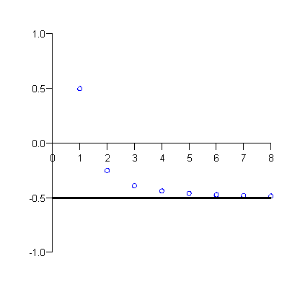
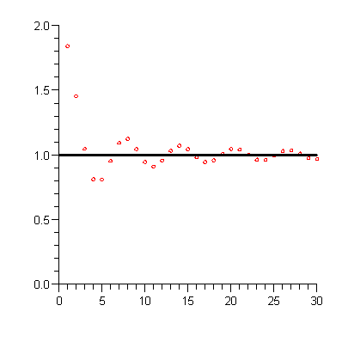
Convergence of Sequencences
A sequence {a_{n}} converges to the number L provided that as we get farther and farther out in the sequence, the terms a_{n} get closer and closer to L.
a_{n}→-1/2
a_{n}→1

Slide 13
Convergence of Sequences
A sequence {a_{n}} converges to the number L provided that as we get farther and farther out in the sequence, the terms a_{n} get closer and closer to L.
{a_{n}} converges provided that it converges to some number. Otherwise we say that it diverges.
In the particular case when a_{n} gets larger and larger without bound as n→∞, we say that {a_{n}} diverges to ∞. (Likewise {a_{n}} can diverge to -∞.)

Slide 14
Convergence notation
A {a_{n}} converges to the limit L, we represent this symbolically by
When {a_{n}} diverges to ±∞, we say

