Slide 1
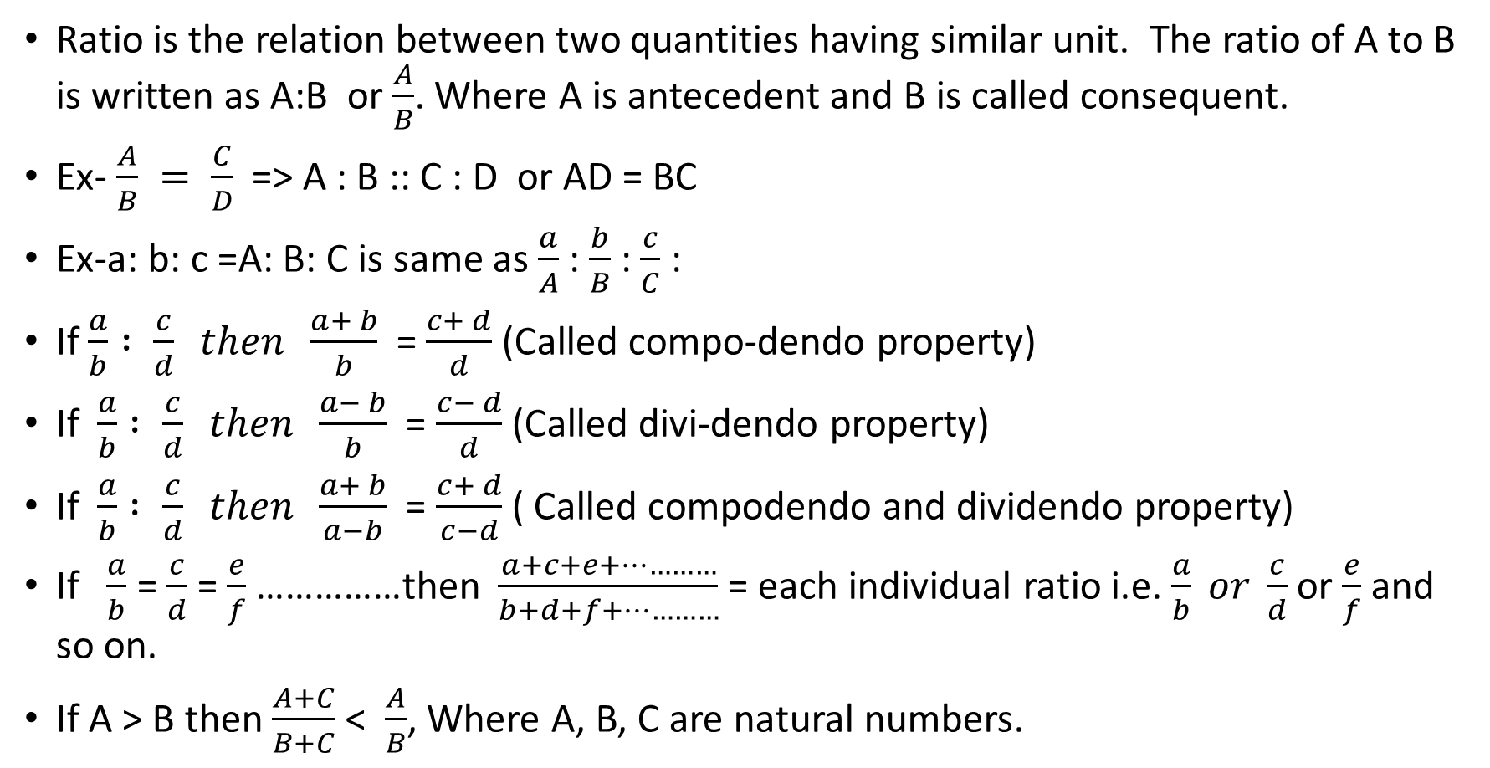
Ratio and Proportion
Ratio is the relation between two quantities having similar unit. The ratio of A to B is written as A:B or $\frac{A}{B}$. Where A is antecedent and B is called consequent.
Ex- $\frac{A}{B} = \frac{C}{D}$=> A : B :: C : D or AD = BC
Ex-a: b: c =A: B: C is same as $\frac{a}{A}$ : $\frac{b}{B}$ : $\frac{c}{C}$ :
If$\frac{a}{b} : \frac{c}{d} then \frac{a+ b}{b}$ = $\frac{c+ d}{d}$ (Called compo-dendo property)
If $\frac{a}{b} : \frac{c}{d} then \frac{a− b}{b}$ = $\frac{c− d}{d}$ (Called divi-dendo property)
If $\frac{a}{b} : \frac{c}{d} then \frac{a+ b}{a−b}$ = $\frac{c+ d}{c−d}$ ( Called compodendo and dividendo property)
If $\frac{a}{b}$ = $\frac{c}{d}$ = $\frac{e}{f}$ ……………then $\frac{a+c+e+…………}{b+d+f+…………}$ = each individual ratio i.e. $\frac{a}{b} or \frac{c}{d}$ or $\frac{e}{f}$and so on.
If A > B then $\frac{A+C}{B+C}$ < $\frac{A}{B}$, Where A, B, C are natural numbers.

Slide 2
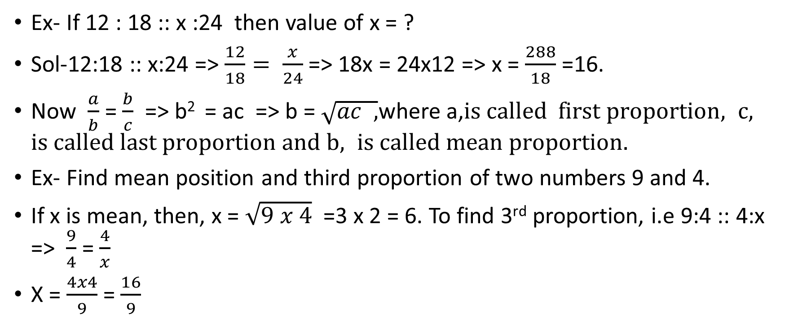
Example of Ratio and proportion
Ex- If 12 : 18 :: x :24 then value of x = ?
Sol-12:18 :: x:24 => $\frac{12}{18}= \frac{x}{24}$ => 18x = 24x12 => x = $\frac{288}{18}$ =16.
Now $\frac{a}{b}$ = $\frac{b}{c}$ => b² = ac => b = $\sqrt{ac , }$where a,$is called first proportion, c, is called last proportion and b, is called mean proportion.$
Ex- Find mean position and third proportion of two numbers 9 and 4.
If x is mean, then, x = $\sqrt{9 x 4}$ =3 x 2 = 6. To find 3rd proportion, i.e 9:4 :: 4:x => $\frac{9}{4}$ = $\frac{4}{x}$
X = $\frac{4x4}{9}$ = $\frac{16}{9}$

Slide 3
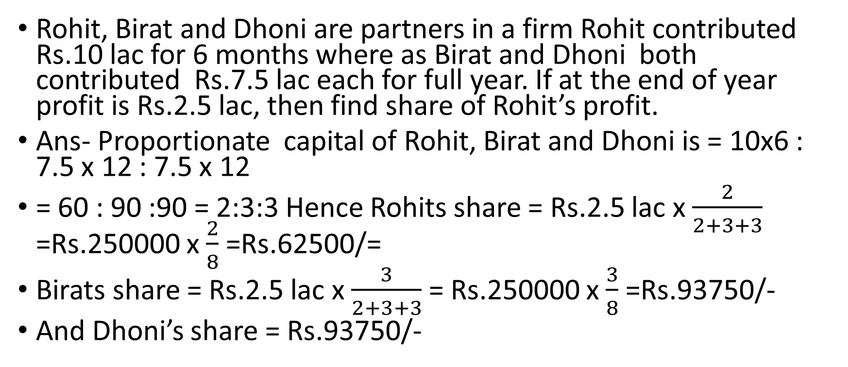
Example of Ratio and Proportion
Rohit, Birat and Dhoni are partners in a firm Rohit contributed Rs.10 lac for 6 months where as Birat and Dhoni both contributed Rs.7.5 lac each for full year. If at the end of year profit is Rs.2.5 lac, then find share of Rohit’s profit.
Ans- Proportionate capital of Rohit, Birat and Dhoni is = 10x6 : 7.5 x 12 : 7.5 x 12
= 60 : 90 :90 = 2:3:3 Hence Rohits share = Rs.2.5 lac x $\frac{2}{2+3+3}$ =Rs.250000 x $\frac{2}{8}$ =Rs.62500/=
Birats share = Rs.2.5 lac x $\frac{3}{2+3+3}$ = Rs.250000 x $\frac{3}{8}$ =Rs.93750/-
And Dhoni’s share = Rs.93750/-

Slide 4
Points to remember
In a partnership, if investment is made by three partners as x_{1 ,} x_{2,} x₃ respectively, for time periods t_{1 ,} t₂ , t₃ then ratio of profit is given by x₁t₁ : x₂t₂ : x₃t₃
If x_{1 ,} x_{2,} x₃ is the ratio of investment and P₁, P_{2,}, P₃ be the ratio of profit then time period is given by P₁ / x₁ : P₂ / x₂ : P₃ / x₃
If t_{1 ,} t_{2,} t₃ is the ratio of time period of investment and P₁, P_{2,}, P₃ be the ratio of profit then respective investments is given by P₁ / t₁ : P₂ / t₂ : P₃ / t

Slide 5
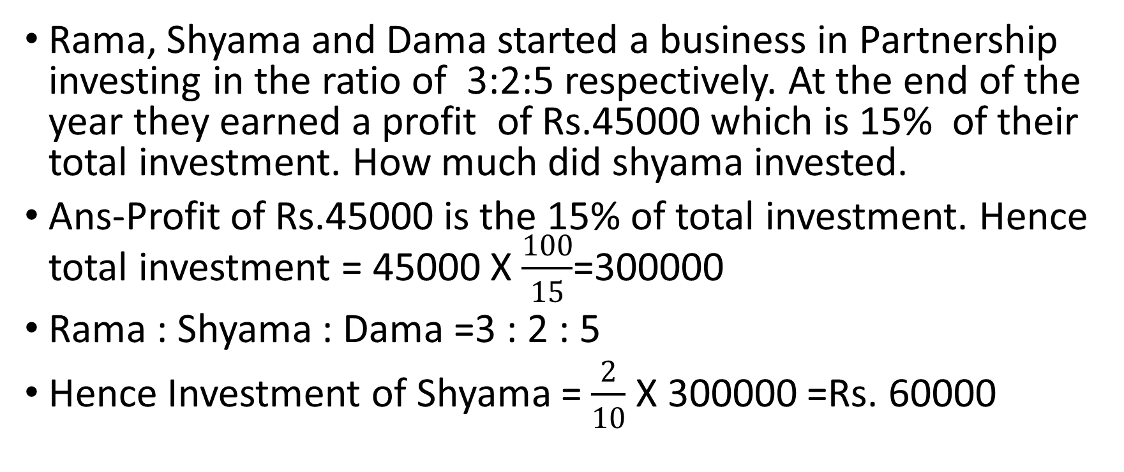
Example
Rama, Shyama and Dama started a business in Partnership investing in the ratio of 3:2:5 respectively. At the end of the year they earned a profit of Rs.45000 which is 15% of their total investment. How much did shyama invested.
Ans-Profit of Rs.45000 is the 15% of total investment. Hence total investment = 45000 X $\frac{100}{15}$=300000
Rama : Shyama : Dama =3 : 2 : 5
Hence Investment of Shyama = $\frac{2}{10}$ X 300000 =Rs. 60000

Slide 6
Thanks

