Slide 1
Profit and Loss
We have to learn how to derive profit and loss of a business concern:-
CP- The price, at which an article is purchased, is called its cost price, abbreviated as C.P.
SP- The price, at which an article is sold, is called its selling prices, abbreviated as S.P
Profit = SP- CP( It is the excess of the selling price over cost price)
Loss = CP – SP(It is the excess of cost price over the selling price)

Slide 2
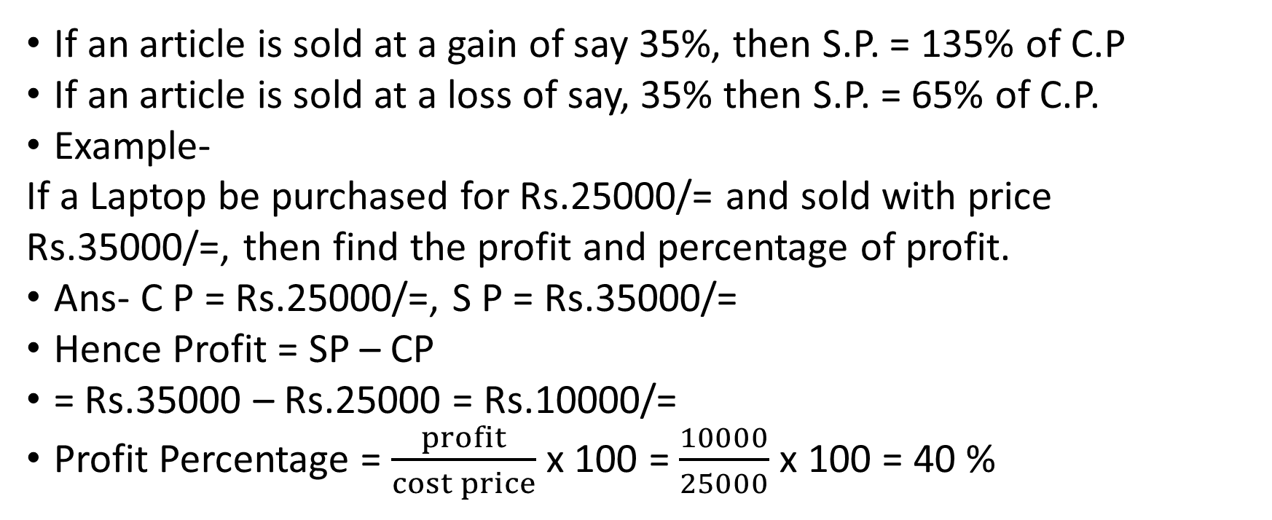
Profot and Loss
If an article is sold at a gain of say 35%, then S.P. = 135% of C.P
If an article is sold at a loss of say, 35% then S.P. = 65% of C.P.
Example-
If a Laptop be purchased for Rs.25000/= and sold with price
Rs.35000/=, then find the profit and percentage of profit.
Ans- C P = Rs.25000/=, S P = Rs.35000/=
Hence Profit = SP – CP
= Rs.35000 – Rs.25000 = Rs.10000/=
Profit Percentage = $\frac{profit}{cost price}$ x 100 = $\frac{10000}{25000}$ x 100 = 40 %

Slide 3
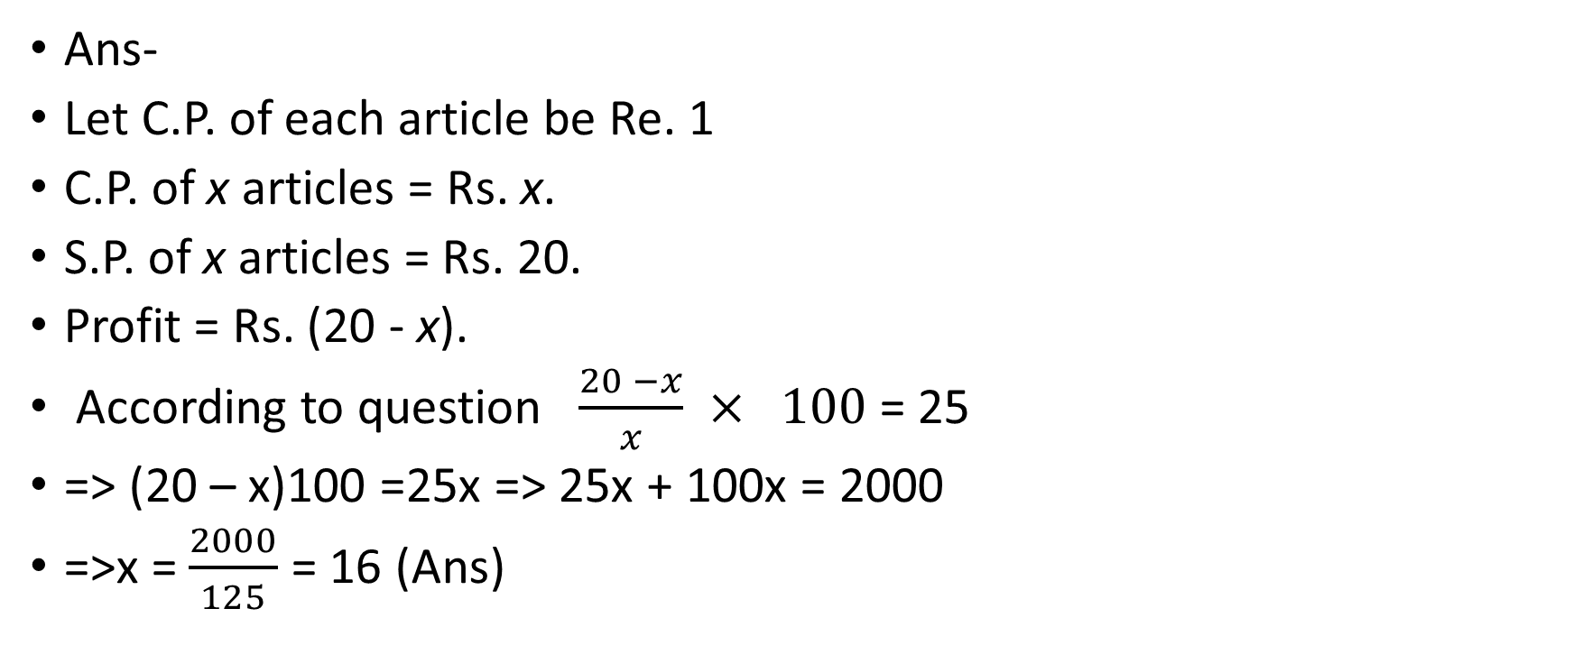
Problem- The cost price of 20 articles is the same as the selling price of x articles. If the profit is 25%, then the value of x is
Ans-
Let C.P. of each article be Re. 1
C.P. of x articles = Rs. x.
S.P. of x articles = Rs. 20.
Profit = Rs. (20 - x).
According to question $\frac{20 −x}{x}$ $× 100$= 25
=> (20 – x)100 =25x => 25x + 100x = 2000
=>x = $\frac{2000}{125}$ = 16 (Ans)

Slide 4
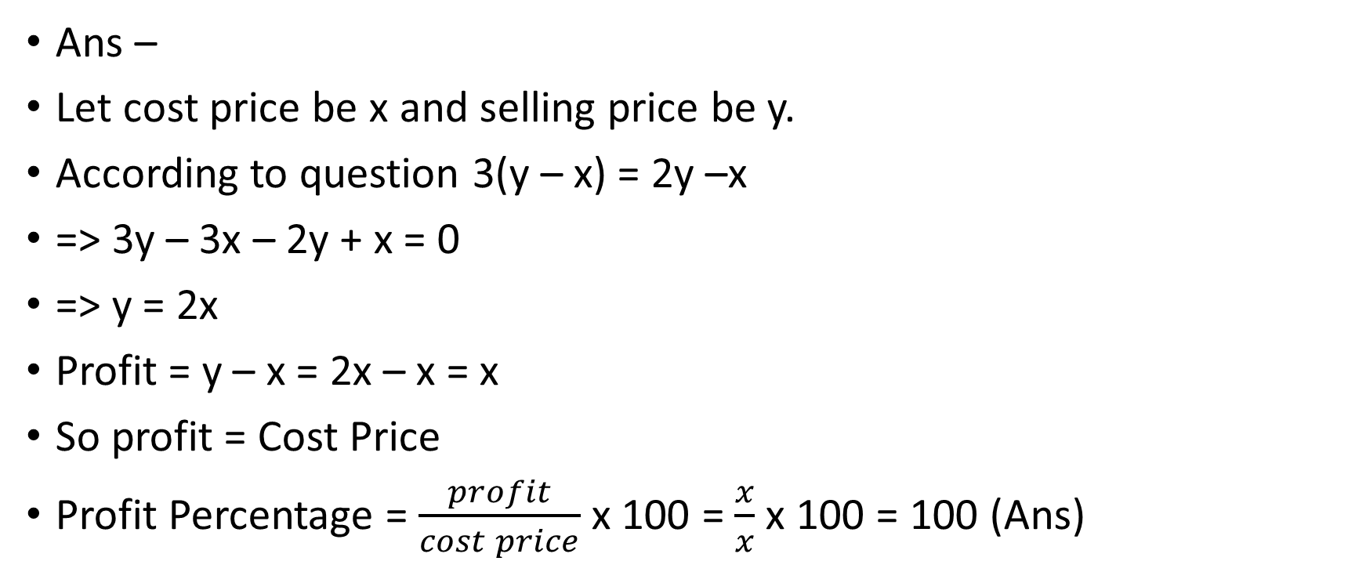
Problem-If selling price is doubled, the profit triples. Find the profit percent
Ans –
Let cost price be x and selling price be y.
According to question 3(y – x) = 2y –x
=> 3y – 3x – 2y + x = 0
=> y = 2x
Profit = y – x = 2x – x = x
So profit = Cost Price
Profit Percentage = $\frac{profit}{cost price}$ x 100 = $\frac{x}{x}$ x 100 = 100 (Ans)

Slide 5
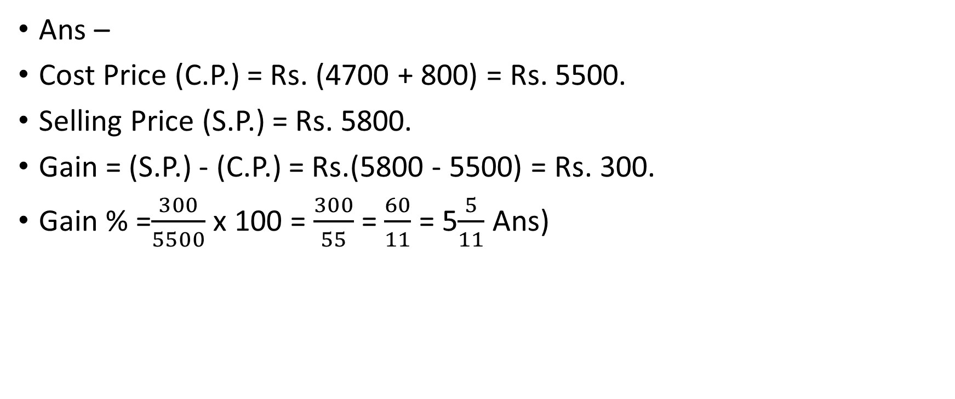
Problem-Alfred buys an old scooter for Rs. 4700 and spends Rs. 800 on its repairs. If he sells the scooter for Rs. 5800, his gain percent is
Ans –
Cost Price (C.P.) = Rs. (4700 + 800) = Rs. 5500.
Selling Price (S.P.) = Rs. 5800.
Gain = (S.P.) - (C.P.) = Rs.(5800 - 5500) = Rs. 300.
Gain % =$\frac{300}{5500}$ x 100 = $\frac{300}{55}$ = $\frac{60}{11}$ = 5$\frac{5}{11}$ Ans)

