Slide 1
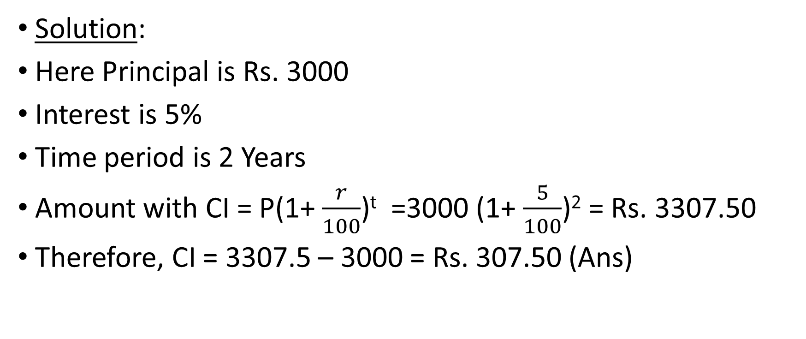
Problem-4-Find the compound interest on Rs. 3000 at 5% for 2 years, compounded annually
Solution:
Here Principal is Rs. 3000
Interest is 5%
Time period is 2 Years
Amount with CI = P(1+ $\frac{r}{100}$)^{t} =3000 (1+ $\frac{5}{100}$)² = Rs. 3307.50
Therefore, CI = 3307.5 – 3000 = Rs. 307.50 (Ans)

Slide 2
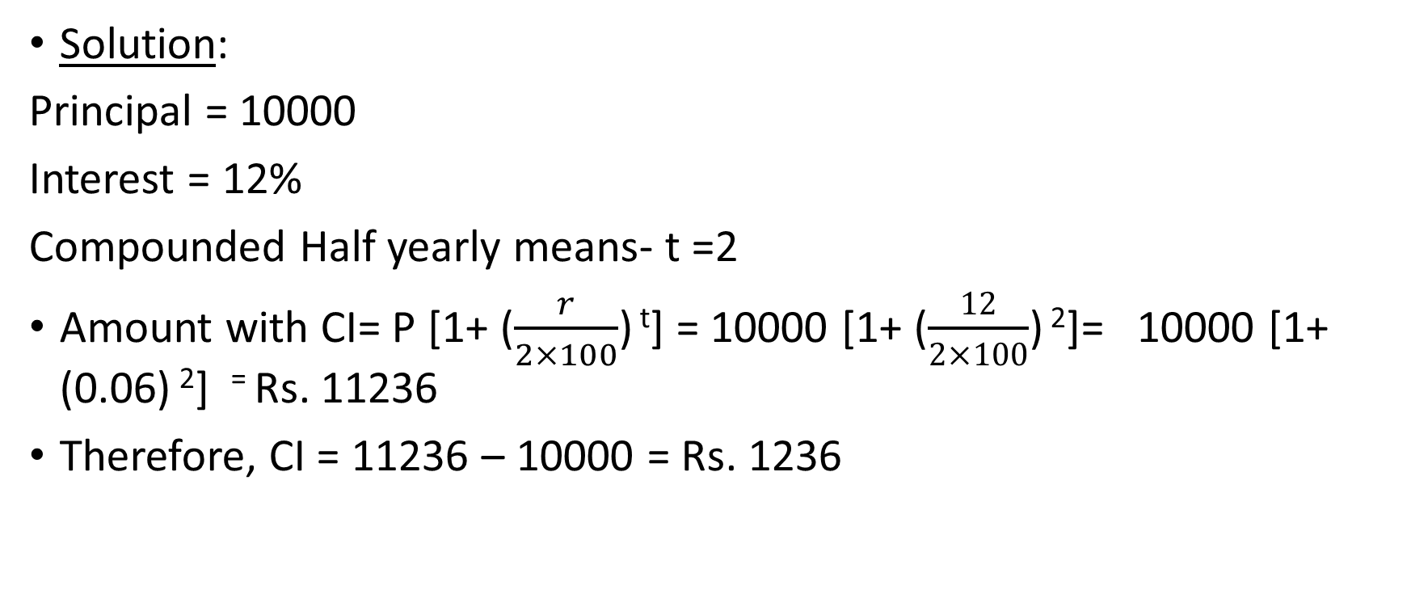
Problem 5. Find the compound interest on Rs. 10000 at 12% rate of interest for 1 year, compounded half-yearly.
Solution:
Principal = 10000
Interest = 12%
Compounded Half yearly means- t =2
Amount with CI= P [1+ ($\frac{r}{2×100}$) ^{t}] = 10000 [1+ ($\frac{12}{2×100}$) ²]= 10000 [1+ (0.06) ²] ⁼ Rs. 11236
Therefore, CI = 11236 – 10000 = Rs. 1236

Slide 3
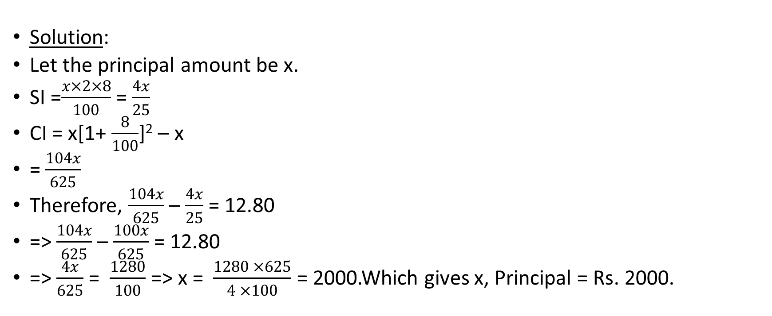
Problem 6. The difference between SI and CI compounded annually on a certain sum of money for 2 years at 8% per annum is Rs. 12.80. Find the principal.
Solution:
Let the principal amount be x.
SI =$\frac{x×2×8}{100}$ = $\frac{4x}{25}$
CI = x[1+ $\frac{8}{100}$]² – x
= $\frac{104x}{625}$
Therefore, $\frac{104x}{625}$ – $\frac{4x}{25}$ = 12.80
=> $\frac{104x}{625}$ – $\frac{100x}{625}$ = 12.80
=> $\frac{4x}{625}$ = $\frac{1280}{100}$ => x = $\frac{1280 ×625}{4 ×100}$ = 2000.Which gives x, Principal = Rs. 2000.

Slide 4

Problem 7. Find the simple interest on Rs. 5000 at a certain rate if the compound interest on the same amount for 2 years is Rs. 253.125.
Solution:
Let the rate of interest be r.
We know Compound Interest = P(1+ $\frac{R}{100}$)^{n} - P
5000[1+ $\frac{r}{100}$]² – 5000 = 253.125
=> [1+ $\frac{r}{100}$]² = $\frac{5000+253.125}{5000}$
Solving which gives
[1+ $\frac{r}{100}$]² = $\frac{1681}{1600}$
=> 1+$\frac{r}{100}$ = $\frac{41}{40}$
=> $\frac{r}{100}$ = $\frac{41}{40}$ – 1 = $\frac{1}{40}$
=> r = $\frac{100}{40}$ =2.5
Therefore, SI = $\frac{P×R×T}{100}=$ $\frac{5000×2.5×2}{100}$ = Rs. 250.(Ans)

Slide 5
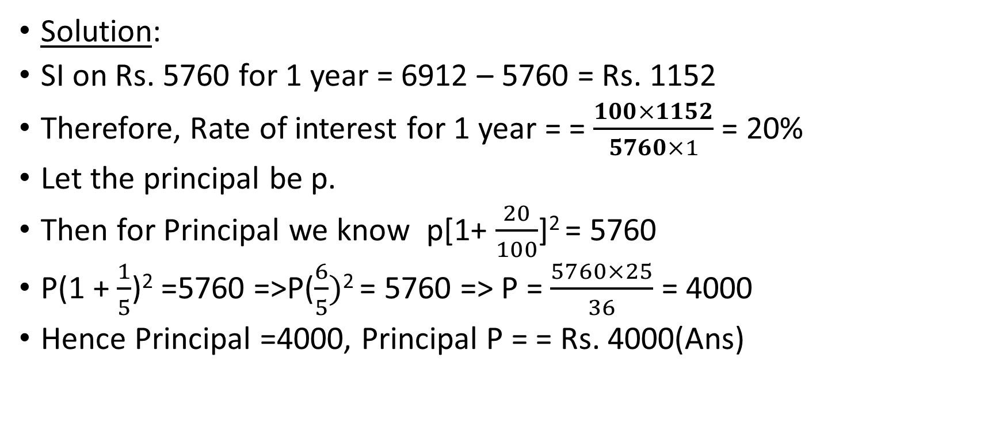
Problem 8. A certain amount becomes Rs. 5760 in 2 years and Rs. 6912 in 3 years. What is the principal amount and the rate of interest?
Solution:
SI on Rs. 5760 for 1 year = 6912 – 5760 = Rs. 1152
Therefore, Rate of interest for 1 year = = $\frac{100×1152}{5760×1}$ = 20%
Let the principal be p.
Then for Principal we know p[1+ $\frac{20}{100}$]² = 5760
P(1 + $\frac{1}{5}$)² =5760 =>P($\frac{6}{5})$² = 5760 => P = $\frac{5760×25}{36}$ = 4000
Hence Principal =4000, Principal P = = Rs. 4000(Ans)

Slide 6

Problem 9. How long will it take a certain amount to increase by 30% at the rate of 15% simple interest?
Solution:
Let the principal be Rs. x
Simple interest = x $×$ $\frac{30}{100}$ = $\frac{3x}{10}$
According to question:
T = $\frac{100×SI }{PR}$
T = $\frac{100×3x}{10×x×15}$ = 2%
So it wll take 2 years. (Ans)

