Slide 1
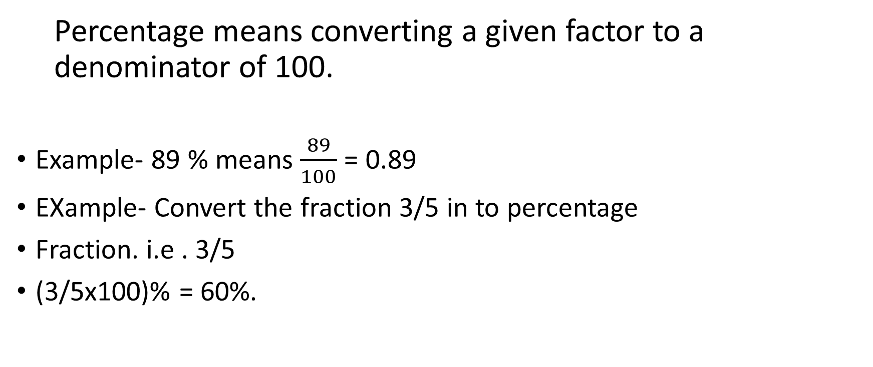
Percentage
  Percentage means converting a given factor to a denominator of 100.
Example- 89 % means $\frac{89}{100}$ = 0.89
EXample- Convert the fraction 3/5 in to percentage
Fraction. i.e . 3/5
(3/5x100)% = 60%.

Slide 2
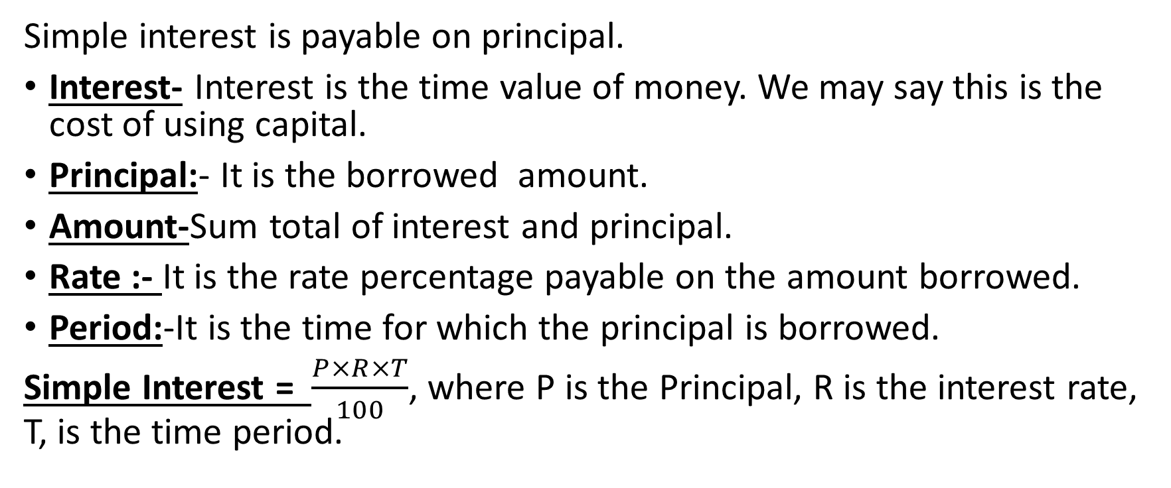
Simple Interest
Simple interest is payable on principal.
Interest- Interest is the time value of money. We may say this is the cost of using capital.
Principal:- It is the borrowed amount.
Amount-Sum total of interest and principal.
Rate :- It is the rate percentage payable on the amount borrowed.
Period:-It is the time for which the principal is borrowed.
Simple Interest = $\frac{P×R×T}{100}$, where P is the Principal, R is the interest rate, T, is the time period.

Slide 3
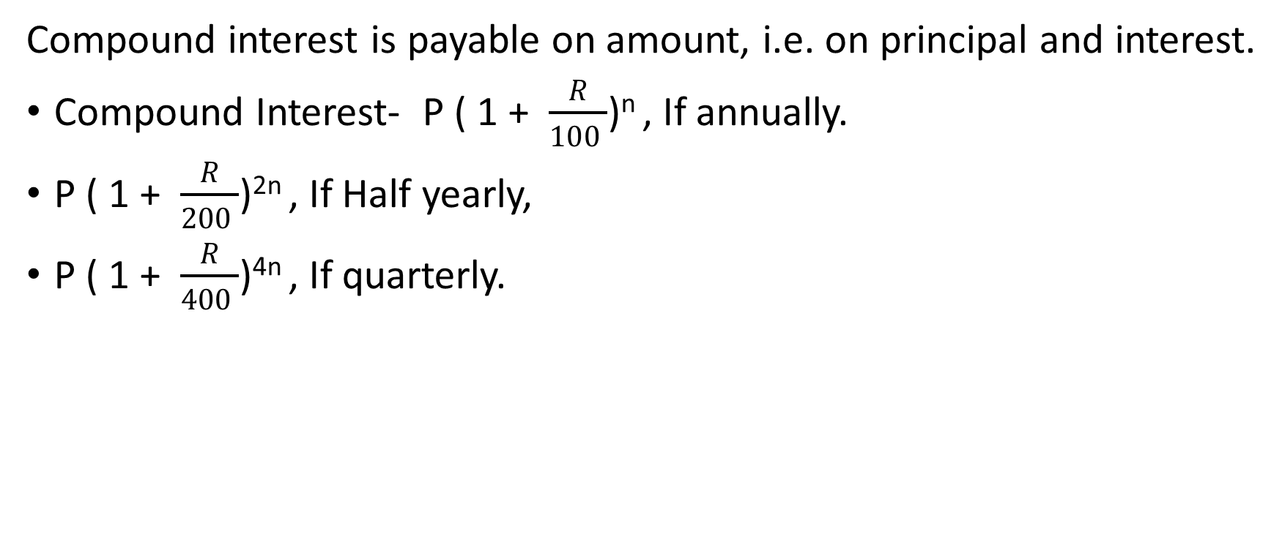
Compound Interest
Compound interest is payable on amount, i.e. on principal and interest.
Compound Interest- P ( 1 + $\frac{R}{100 }$)^{n} , If annually.
P ( 1 + $\frac{R}{200 }$)^{2n} , If Half yearly,
P ( 1 + $\frac{R}{400 }$)^{4n} , If quarterly.

Slide 4

Problem-A sum of Rs. 25000 becomes Rs. 27250 at the end of 3 years when calculated at simple interest. Find the rate of interest.
Solution:
Simple interest = 27250 – 25000 = 2250
Time = 3 years.
SI = $\frac{P×R×T}{100}$ => R = $\frac{100×SI}{P ×T}$
R = $\frac{100×2250}{25000 ×3}$ => R = 3%.

Slide 5
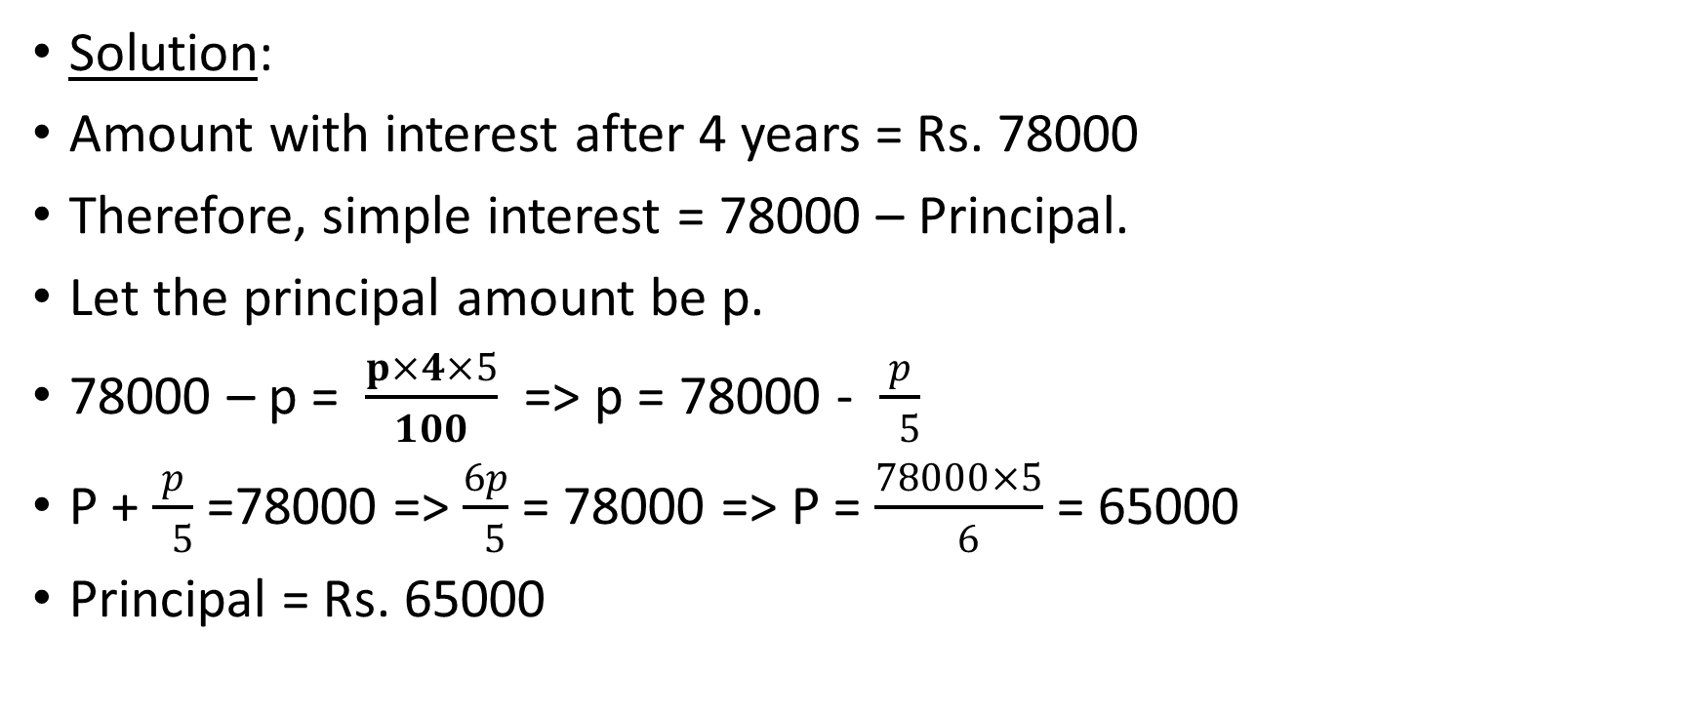
Problem 2. Find the present worth of Rs. 78000 due in 4 years at 5% interest per year.
Solution:
Amount with interest after 4 years = Rs. 78000
Therefore, simple interest = 78000 – Principal.
Let the principal amount be p.
78000 – p = $\frac{p×4×5}{100}$ => p = 78000 - $\frac{p}{ 5}$
P + $\frac{p}{ 5}$ =78000 => $\frac{6p}{ 5}$ = 78000 => P = $\frac{78000×5}{ 6}$ = 65000
Principal = Rs. 65000

Slide 6
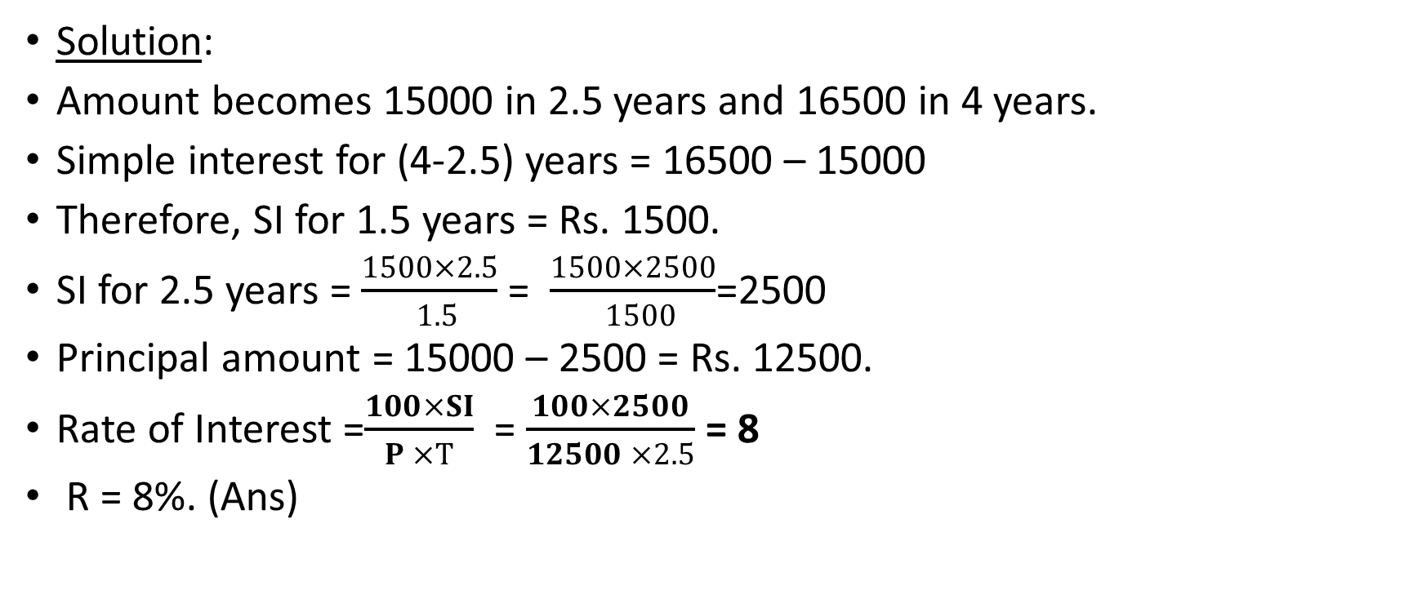
Problem 3. A certain principal amounts to Rs. 15000 in 2.5 years and to Rs. 16500 in 4 years at the same rate of interest. Find the rate of interest.
Solution:
Amount becomes 15000 in 2.5 years and 16500 in 4 years.
Simple interest for (4-2.5) years = 16500 – 15000
Therefore, SI for 1.5 years = Rs. 1500.
SI for 2.5 years = $\frac{1500×2.5}{ 1.5}$ = $\frac{1500×2500}{ 1500}$=2500
Principal amount = 15000 – 2500 = Rs. 12500.
Rate of Interest =$\frac{100×SI}{P ×T}$ = $\frac{100×2500}{12500 ×2.5}$ = 8
R = 8%. (Ans)

