Slide 1
What is pie chart?
A type of graph in which a circle is divided into sectors that each represent a proportion of the whole.
A pie chart (or a circle chart) is a circular statistical graphic which is divided into slices to illustrate numerical proportion

Slide 2
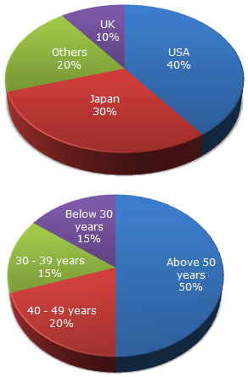
Pie Chart
The given pie charts exhibit the distribution of the overseas tourist traffic from India. The two charts shows the tourist distribution by country and the age profiles of the tourists respectively.
Q-What percentage of Indian tourist went to either USA or UK ? Answer-(40+10) = 50% (from first chart)

Slide 3
Q-The ratio of the number of Indian tourists that went to USA to the number of Indian tourists who were below 30 years of age is ? Answer-40:15 = 8:3

Slide 4
Q-If amongst other countries, Switzerland accounted for 25% of the Indian tourist traffic, and it is known from official Swiss records that a total of 25 lakh Indian tourists had gone to Switzerland during the year, then find the number of 30-39 year old Indian tourists who went abroad in that year ?
Answer-Tourist traffic from other countries to Swiz is 20%. Amongst this 20%, 25% of traffic from India. So, 25% of 20% = 5% corresponds to the Indian traffic in Switzerland. 5 % corresponds to Switzerland's 25 lakh. Hence 15% will be 75 lakh.

Slide 5
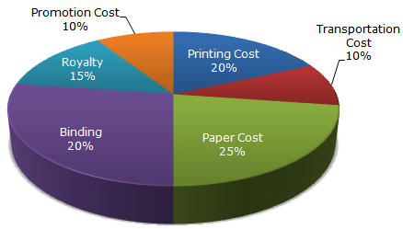
Pie Chart-The following pie-chart shows the percentage distribution of the expenditure incurred in publishing a book. Study the pie-chart and the answer the questions based on it.
If for a certain quantity of books, the publisher has to pay Rs. 30,600 as printing cost, then what will be amount of royalty to be paid for these books?
Ans-Let the Royalty to be paid is ‘x’
Then 20 : 15 = 30600 : x
X = $\frac{30600×15}{20}$ = 22950
Q-2What is the central angle of the
Sector corresponding to the expenditure incurred in Royality?
Ans- 15% of 360 $°$ = 54$°$

Slide 6
Q- The price of the book is marked 20% above the C.P. If the marked price of the book is Rs. 180, then what is the cost of the paper used in a single copy of the book?
Ans-Marked price of the book = 120% of C.P.
Also, cost of paper = 25% of C.P
Let the cost of paper for a single book be Rs. n.
Then, 120 : 25 = 180 : n => n= $\frac{180×25}{120}$ = 37.50

Slide 7
Q-If 5500 copies are published and the transportation cost on them amounts to Rs. 82500, then what should be the selling price of the book so that the publisher can earn a profit of 25%?
Answer-
For the publisher to earn a profit of 25%,
S.P. = 125% of C.P.
Also Transportation Cost = 10% of C.P.
Let the S.P. of 5500 books be Rs. X
Then, 10 : 125 = 82500 : x
=> x = (82500×125)/10 = 1031250
So SP of one book = "1031250 " /5500 = 187.50

Slide 8
Thank you

