Slide 1
BOAT AND STREAM
When we move upstream the speed gets deducted from the speed of the stream and when we move down stream our speed gets added to the speed of the stream.

Slide 2
CONDITION FOR UPSTREAM AND DOWNSTREAM
If the speed of the boat in still water is A km/hr and speed of the stream be B km/hr, then
Speed of boat with the stream i.e speed downstream= (A+B)km/hr
Speed of boat against the stream i.e
Speed upstream =(A-B)km/hr

Slide 3
Speed of boat in still water
=
$$\frac{Speed downstream+speed upstream}{2}$$

Slide 4
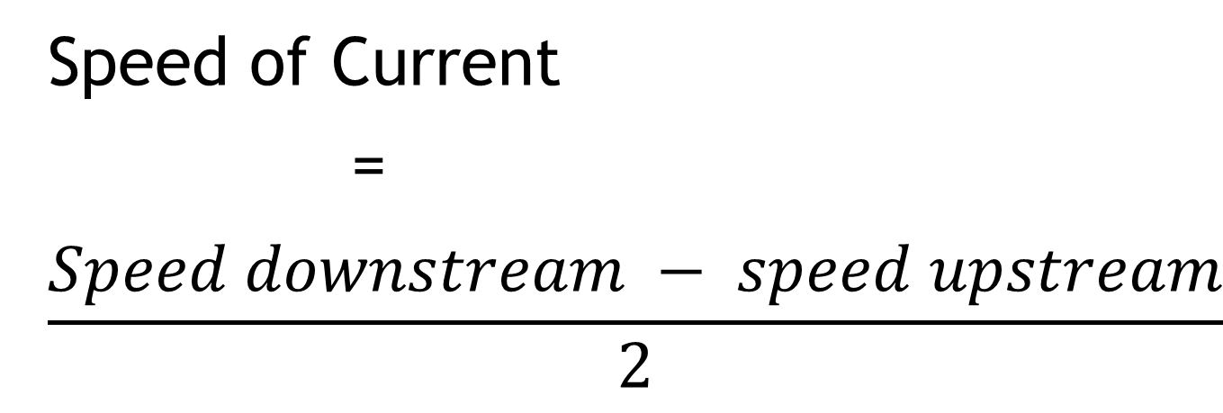
Speed of Current
=
$$\frac{Speed downstream − speed upstream}{2}$$

Slide 5
EXAMPLE
If a boat moves equal distances down stream at a speed 20 km/hr and upstream at a speed 10 km/hr, then what is the speed of boat in still water.
Sol- Speed of boat in still water
= $\frac{Speed downstream+speed upstream}{2}$
= $\frac{20 km/hr+10km/hr}{2}$
=30/2 = 15 km/hr

Slide 6
Thank you

