Slide 1
BODMAS RULE
This rule says the correct sequence in which the operations are to be executed, to find out the value of given expression.
B - Bracket, O - of, or order D - Division, M - Multiplication, A - Addition and S - Subtraction

Slide 2
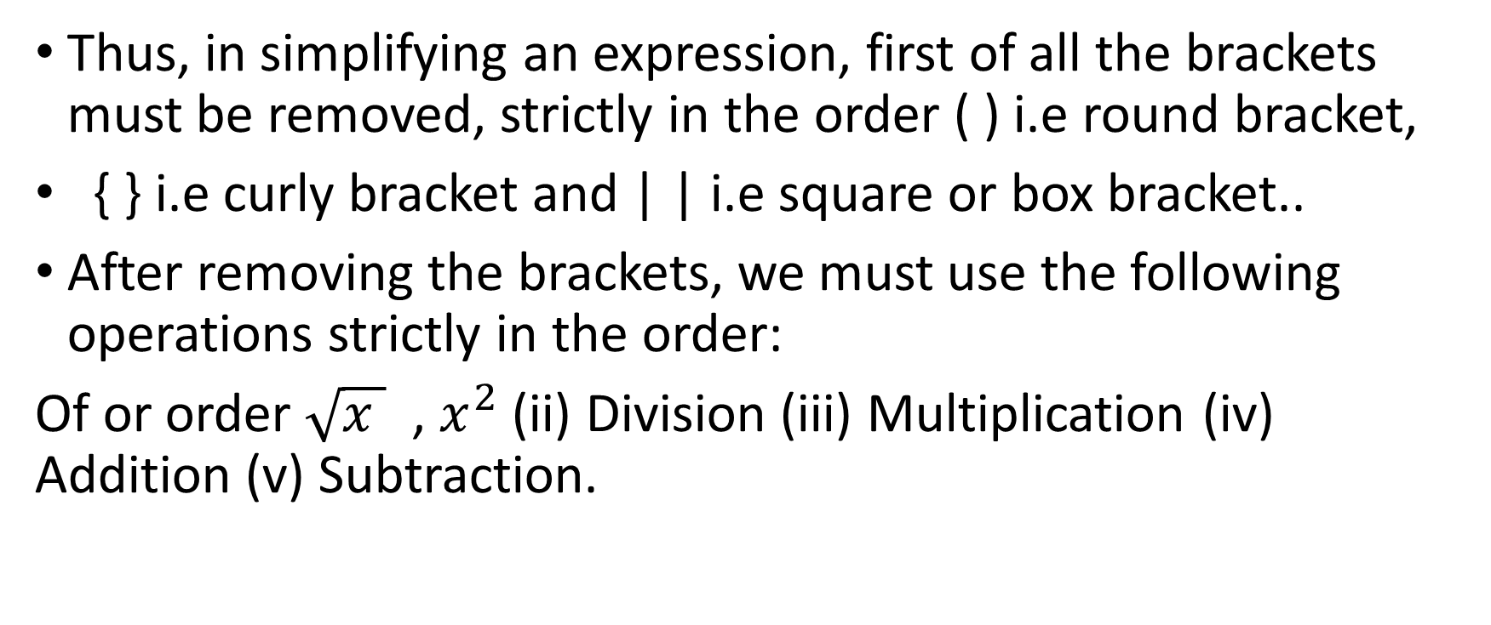
BODMAS Rule
Thus, in simplifying an expression, first of all the brackets must be removed, strictly in the order ( ) i.e round bracket,
{ } i.e curly bracket and | | i.e square or box bracket..
After removing the brackets, we must use the following operations strictly in the order:
Of or order $\sqrt{x }$ , $x^{2}$ (ii) Division (iii) Multiplication (iv) Addition (v) Subtraction.

Slide 3
Example
What will come in place of question mark (?) in the following question?
24 + 13 – 5 × ½ of 10 - {45 ÷ (17 – 2)} =?
Ans- 24 + 13 – 5 × ½ of 10 - {45 ÷ (15)} =?
=>24 + 13 – 5 × ½ of 10 - {3} =?
=>24 + 13 – 5 × 5 - 3 =?
=>24 + 13 – 25 - 3 =?
=>37 – 25 - 3
12 – 3 = ?
? = 9 (AnS)

Slide 4
Problem
What will come in place of question mark (?) in the following question?
240 ÷ 8 × 512 ÷ 4 + ½ of {1800 ÷ (11 × 24 ÷ 8 × 3 – 69)²} = ?
Ans-Given expression is,
240 ÷ 8 × 512 ÷ 4 + ½ of {1800 ÷ (11 × 24 ÷ 8 × 3 – 69)²} = ?
According to the BODMAS, first we need to solve the Brackets.
⇒ 240 ÷ 8 × 512 ÷ 4 + ½ of {1800 ÷ (264 ÷ 8 × 3 – 69)²} = ?
⇒ 240 ÷ 8 × 512 ÷ 4 + ½ of {1800 ÷ (33 × 3 – 69)²} = ?
⇒ 240 ÷ 8 × 512 ÷ 4 + ½ of {1800 ÷ (99 – 69)²} = ?
⇒ 240 ÷ 8 × 512 ÷ 4 + ½ of {1800 ÷ 30²} = ?
⇒ 240 ÷ 8 × 512 ÷ 4 + ½ of {1800 ÷ 900} = ?
⇒ 240 ÷ 8 × 512 ÷ 4 + ½ of 2 = ?
⇒ 240 ÷ 8 × 512 ÷ 4 + ½ × 2 = ?
⇒ 240 ÷ 8 × 512 ÷ 4 + 1 = ?
⇒ 30 × 512 ÷ 4 + 1 = ?
⇒ 15360 ÷ 4 + 1 = ?
⇒ 3840 + 1 = ?
⇒ ? = 3841 (Ans)

