Slide 1
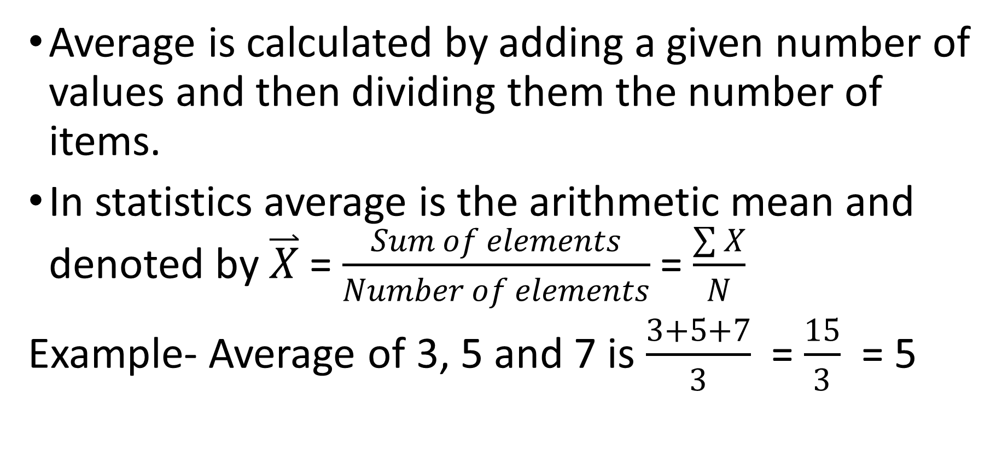
Average
Average is calculated by adding a given number of values and then dividing them the number of items.
In statistics average is the arithmetic mean and denoted by $\overset{⃑}{X}$ = $\frac{Sum of elements}{Number of elements}$ = $\frac{\sum{X}}{N}$
Example- Average of 3, 5 and 7 is $\frac{3+5+7}{3}$ = $\frac{15}{3}$ = 5

Slide 2
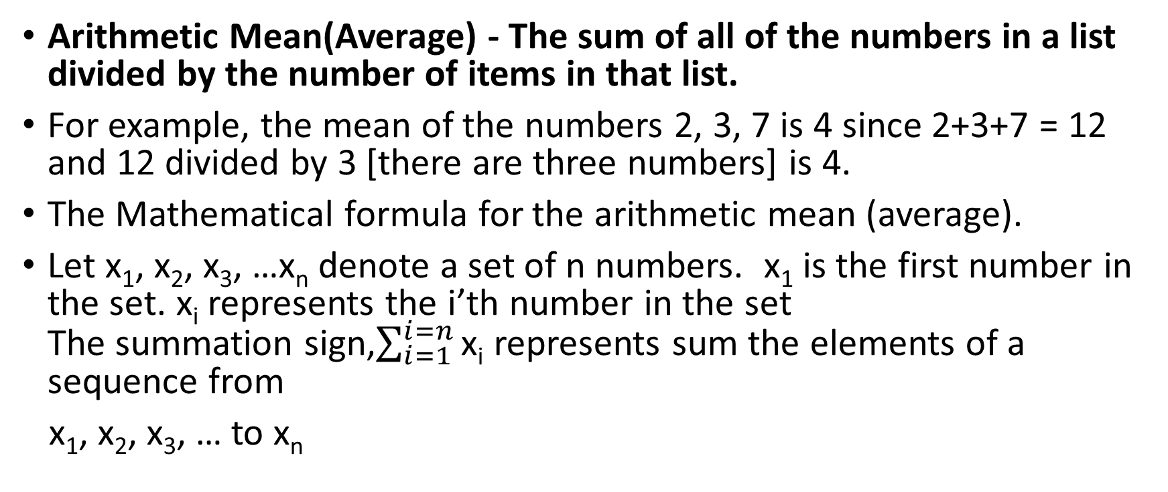
Mean
Arithmetic Mean(Average) - The sum of all of the numbers in a list divided by the number of items in that list.
For example, the mean of the numbers 2, 3, 7 is 4 since 2+3+7 = 12 and 12 divided by 3 [there are three numbers] is 4.
The Mathematical formula for the arithmetic mean (average).
Let x₁, x₂, x₃, …x_{n} denote a set of n numbers. x₁ is the first number in the set. x_{i} represents the i’th number in the set
The summation sign,$\sum_{i=1}^{i=n}{\text{x}\text{i}}$ represents sum the elements of a sequence from
x₁, x₂, x₃, … to x_{n}

Slide 3
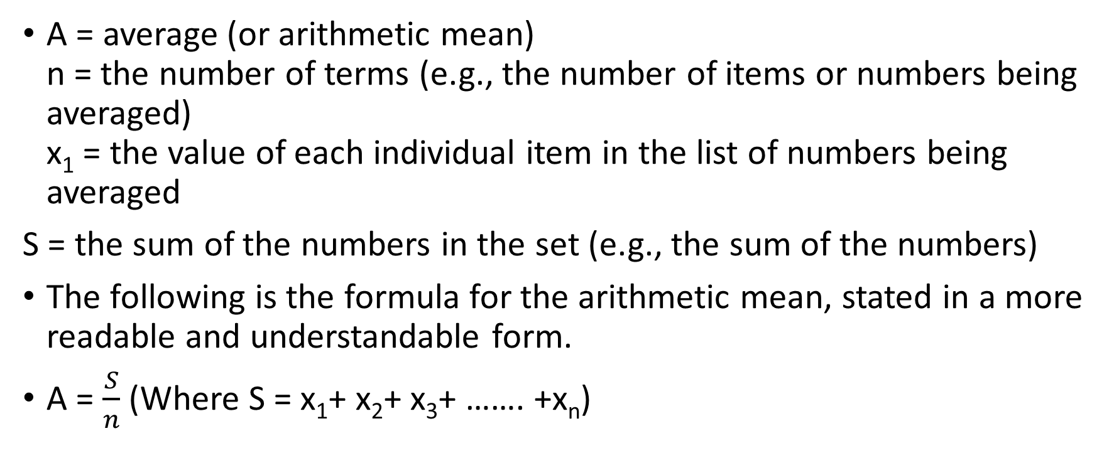
Arithmetic Mean
A = average (or arithmetic mean)
n = the number of terms (e.g., the number of items or numbers being averaged)
x₁ = the value of each individual item in the list of numbers being averaged
S = the sum of the numbers in the set (e.g., the sum of the numbers)
The following is the formula for the arithmetic mean, stated in a more readable and understandable form.
A = $\frac{S}{n}$ (Where S = x₁+ x₂+ x₃+ ……. +x_{n})

Slide 4
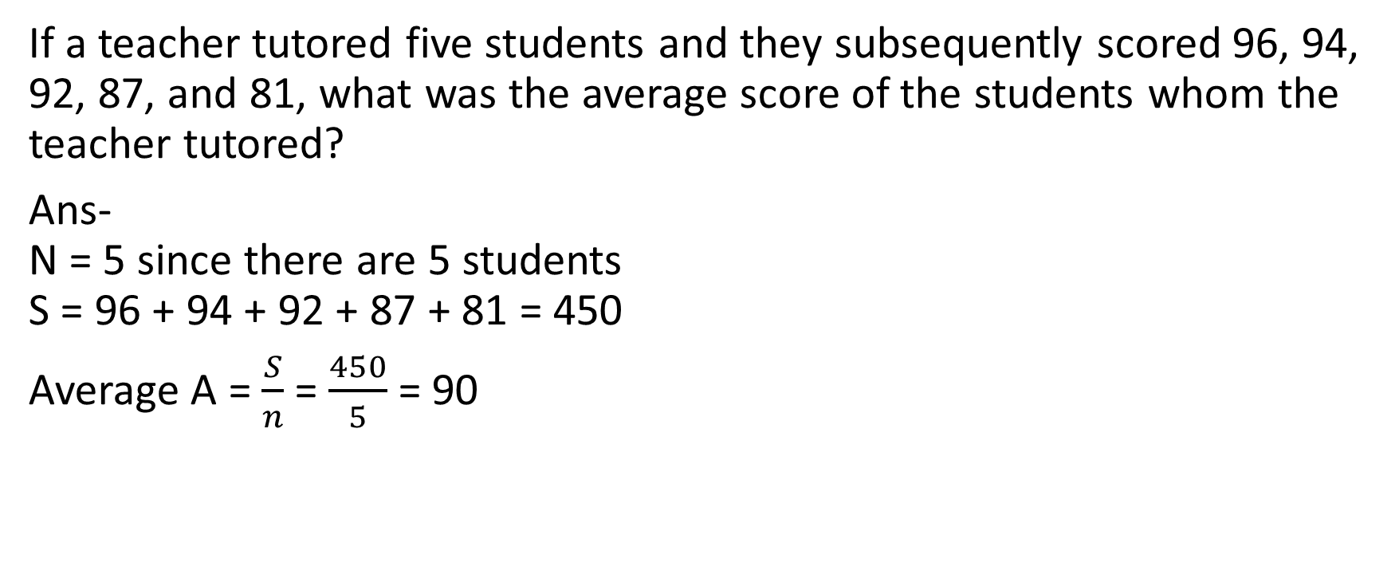
Example
If a teacher tutored five students and they subsequently scored 96, 94, 92, 87, and 81, what was the average score of the students whom the teacher tutored?
Ans-
N = 5 since there are 5 students
S = 96 + 94 + 92 + 87 + 81 = 450
Average A = $\frac{S}{n}$ = $\frac{450}{5}$ = 90

Slide 5

Example
If a baseball pitcher throws three straight strikes to the first batter, two strikes to the second batter, one strike to the third batter, and zero strikes to the fourth batter, what is the average number of strikes the pitcher threw to each of the four batters?
Solution-
N = 4 since there are four batters
S = 3 + 2 + 1 + 0 = 6

