Slide 1
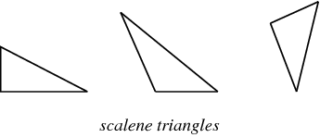
Area of close shapes
Triangles: A triange is a polygon having three sides and three angles.
Sum of the angles of a triangle is 180°.
Area =½ × b × h
Peremeter = a + b +c ,
where a, b, c are three sides of triangle

Slide 2
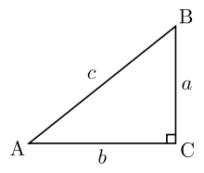
Area of triangle
The sum of any two sides of a triangle is greater than the third side.
Area = $\frac{1}{2}$x Base x Height. = $\frac{1}{2}x$ b x h
Area of a triangle = $\sqrt{\text{s}\text{(}\text{s}\text{−}\text{a}\text{)(}\text{s}\text{−}\text{b}\text{)(}\text{s}\text{−}\text{c}\text{) }}$ where a, b, c are the sides of the triangle and s = $\frac{1}{2}$ (a + b + c).
If all angles of a triangle is less than 90 degree called ACUTE angled triangle
If one angle of a triangle is more than 90 degree then it is called OBTUSE angled triange
And if one angle of a triangle is 90 degree is called RIGHT angled triange.
Pythagoras Theorem:
In a right-angled triangle, (Hypotenuse)² = (Base)² + (Height)².
In above diagram angle C is right angle i.e 90°
(AB)² = (AC)² + (BC)²
c² = b² + a²

Slide 3
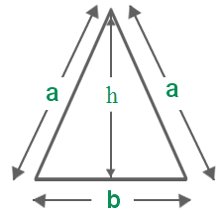
Triange… contd………….
The line joining the mid-point of a side of a triangle to the positive vertex is called the median.
The point where the three medians of a triangle meet, is called centroid. The centroid divided each of the medians in the ratio 2 : 1.
In an isosceles triangle, the altitude from the vertex bisects the base.
Perimeter of an isosceles triangle = a + a + b = 2a + b
Area = $\frac{1}{2}$x Base x Height. = $\frac{1}{2}x$ b x h
Here h² = a² - ($\frac{b}{2}$)²
The median of a triangle divides it into two triangles of the same area.

Slide 4
Equilateral triange
The area of the triangle formed by joining the mid-points of the sides of a given triangle is one-fourth of the area of the given triangle.
Equilateral triangle
Three sides are equal and three angles are equal.
If ‘s’ is the side of an equilateral triangle then Perimeter = 3 s

Slide 5
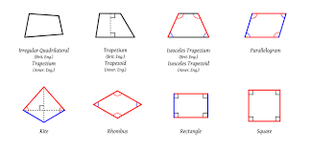
Quadrilaterals:
Quadrilateral is a four-sided figure and four angle total together is 360$°$
May be a rectangle, Square, Parallelogram, a Rhombus or a trapezium.
Rectangle-
A rectangle is a quadrilateral with four right angles.
Also opposite lines are equal and parallel.
It can also be defined as an equiangular quadrilateral,
since equiangular means that all of its angles are equal.
If two opposite sides of a rectangle are w and h then perimeter
Perimeter of a rectangle = 2(Length + Breadth) = 2(w + h)
Area of a rectangle = (Length x Breadth).
Area = w $×h$
And diagonals of a rectangle are equal and bisect each other.

Slide 6
Square
A square is a four sided figure created by connecting four equal line segments and they come together to form four right angles.
All four sides are equal and four angles are equal = 90 degree.
If ‘a’ is each side of a square then Perimeter = 4 a
And area of a square A = a²
The diagonals of a square are equal and bisect each other at right angles.

Slide 7
Rhombus
A rhombus is a four-sided shape where all sides have equal length and parallel and opposite angles are equal. Another interesting thing is that the diagonals meet in the middle at a right angle. i.e they "bisect" (cut in half) each other at right angles. A rhombus is a special type of parallelogram of four equal sides. The diagonals of a rhombus are unequal and bisect each other at right angles.
The area is the product of two adjacent sides. i.e ba b is the length of the base a is the altitude (height).
Also Area $\frac{1}{2}$d₁ x d₂
Where d₁ is the length of a diagonal d₂ is the length of the other diagonal

Slide 8
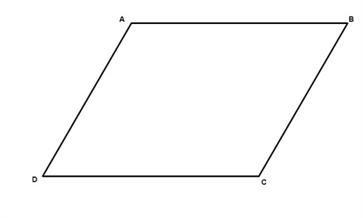
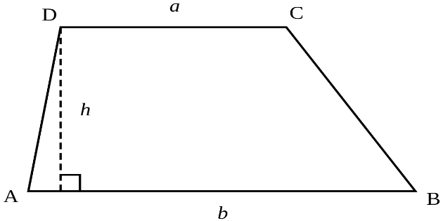
Parallelogram
A parallelogram is a four-sided plane rectilinear figure with opposite sides parallel.
A parallelogram and a rectangle on the same base and between the same parallels are equal in area.
Area of parallelogram = (Base x Height).
Trapezium
A trapezium is a quadrilateral with one pair of sides parallel.
The area of a trapezium=$\frac{1}{2}$ (sum of parallel sides $×\text{distance} \text{between} \text{them}\text{.}$)
Area =$\frac{1}{2}$ h (a +b )

Slide 9
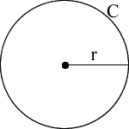
Circle
Area of a circle =$π$ r², where ‘r’ is the radius. If d stands for diameter then d =2r.
Circumference of a circle = 2$π$ r
Length of an arc = $\frac{\text{2} π \text{r}}{360}$ $θ$, where $θ$ is the central angle
Area of a sector =$\frac{\text{1}}{2}$ (arc x r) = $\frac{ π\text{r}\text{2}}{360}$ $θ$
Circumference of a semi-circle = $π$ r
Area of semi-circle = $\frac{\text{1}}{2}$ $π\text{r}\text{2}$

