Slide 1
Algebra
To learn algebra requires deep understanding of formulas, terms and concept. Hence, to ease this task we provide few Algebra Formulas, in one place to learn, understand, clear thorough concept, grasp, and practice, have the full confidence and excel by solving problem easily in any examination. Remember the formulas below
(a+b)² =a²+2ab+b²
(a−b)² = a²-2ab+b²
(a+b)(a–b) = a²– b²
(x+a)(x+b) = x²+(a+b)x+ab
(x+a)(x–b) = x²+(a–b)x–ab
(x–a)(x+b) = x²+(b–a)x–ab and (x – a)(x – b) = x²-(a+b)x+ab

Slide 2
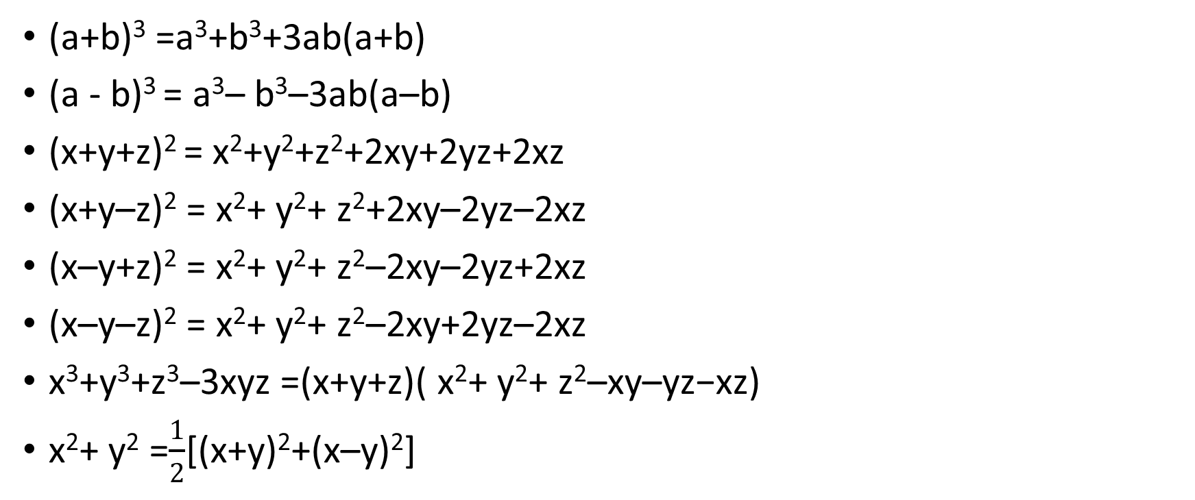
Formulas
(a+b)³ =a³+b³+3ab(a+b)
(a - b)³ = a³– b³–3ab(a–b)
(x+y+z)² = x²+y²+z²+2xy+2yz+2xz
(x+y–z)² = x²+ y²+ z²+2xy–2yz–2xz
(x–y+z)² = x²+ y²+ z²–2xy–2yz+2xz
(x–y–z)² = x²+ y²+ z²–2xy+2yz–2xz
x³+y³+z³–3xyz =(x+y+z)( x²+ y²+ z²–xy–yz−xz)
x²+ y² =$\frac{1}{2}$[(x+y)²+(x–y)²]

Slide 3
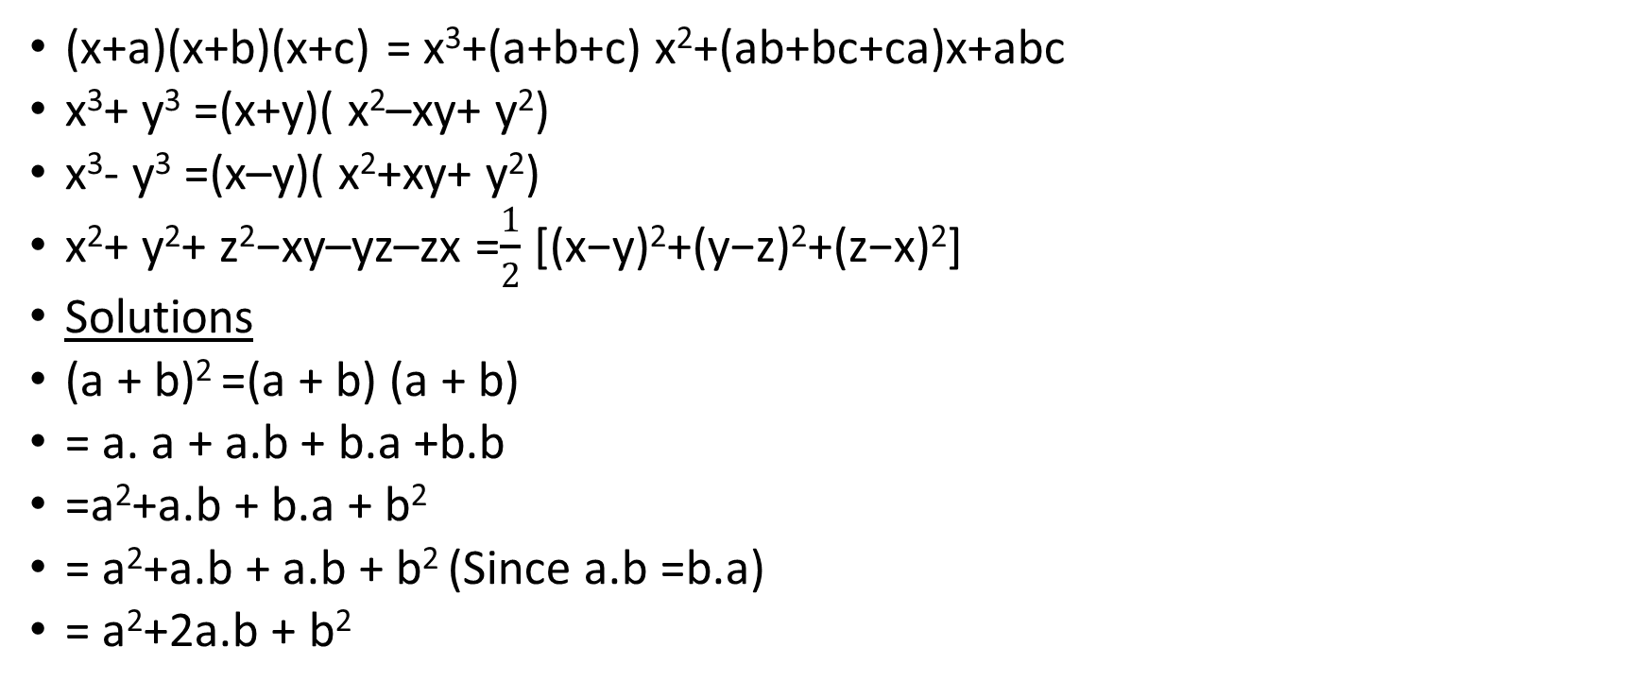
Formulas
(x+a)(x+b)(x+c) = x³+(a+b+c) x²+(ab+bc+ca)x+abc
x³+ y³ =(x+y)( x²–xy+ y²)
x³- y³ =(x–y)( x²+xy+ y²)
x²+ y²+ z²−xy–yz–zx =$\frac{1}{2}$ [(x−y)²+(y−z)²+(z−x)²]
Solutions
(a + b)² =(a + b) (a + b)
= a. a + a.b + b.a +b.b
=a²+a.b + b.a + b²
= a²+a.b + a.b + b² (Since a.b =b.a)
= a²+2a.b + b²

Slide 4
Solutions
(a +b)³ =(a+b) (a+b) (a+b)
=(a+b)( a²+2a.b + b²)
=a (a²+2a.b + b²) + b (a²+2a.b + b²)
=a. a² +a. 2a.b + a. b²+b. a²+ b. 2 a b + b b²
=a³+2 a² b + ab² + b a²+2ab²+ b³
= a³+2 a² b + b a² + ab²+ 2ab²+ b³
= a³+(2 a² b + b a²) + (ab²+ 2ab² ) + b³
= a³+3 a² b + 3ab²+ b³
= a³+ b³+3ab(a + b)

Slide 5


Examples
1 - 8 x³
=(1)³ – (2x)³
=(1 – 2x)(1² +1. 2x + (2x)²)
=(1 – 2x)(1 +2x + 4 x² )(Ans)
Exercise- Let x≠ ±y. Evaluate:
Ans-

